Slide 1
From Pixels to Nucleotides
Deep Learning for Computer Vision and Drug Design
Alexey Dosovitskiy
ML in PL, Warsaw
October 17, 2025

Slide 2


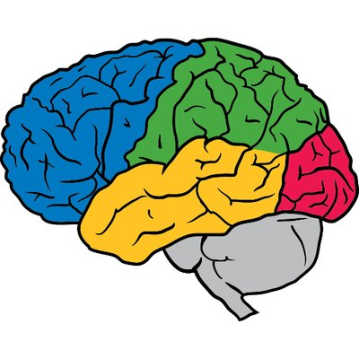



Research Bio tl;dr
Computer vision
Transformers
ML for drug design
Time

Slide 3
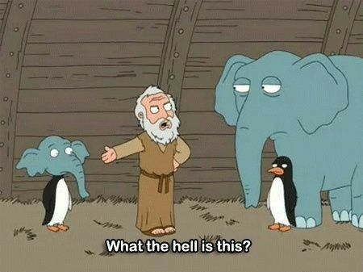
Computer vision and “off-the-grid”
This talk
ML for drug design

Slide 4
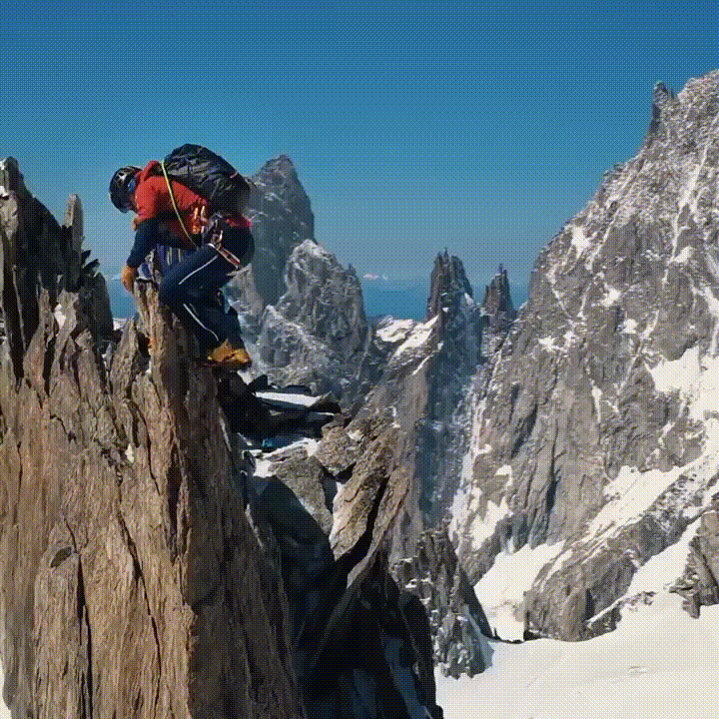
The World is 3D and Dynamic
https://www.youtube.com/shorts/vOcqoLGX2jI

Slide 5
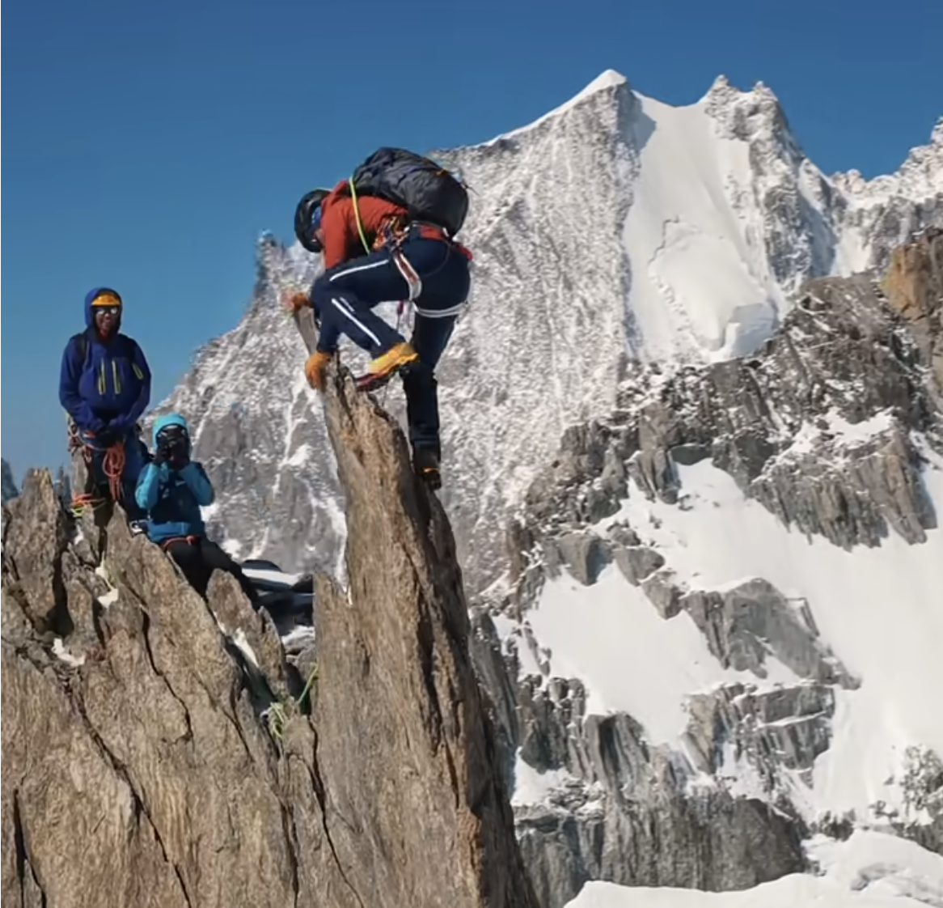
The World is 3D and Dynamic
https://www.youtube.com/shorts/vOcqoLGX2jI

Slide 6
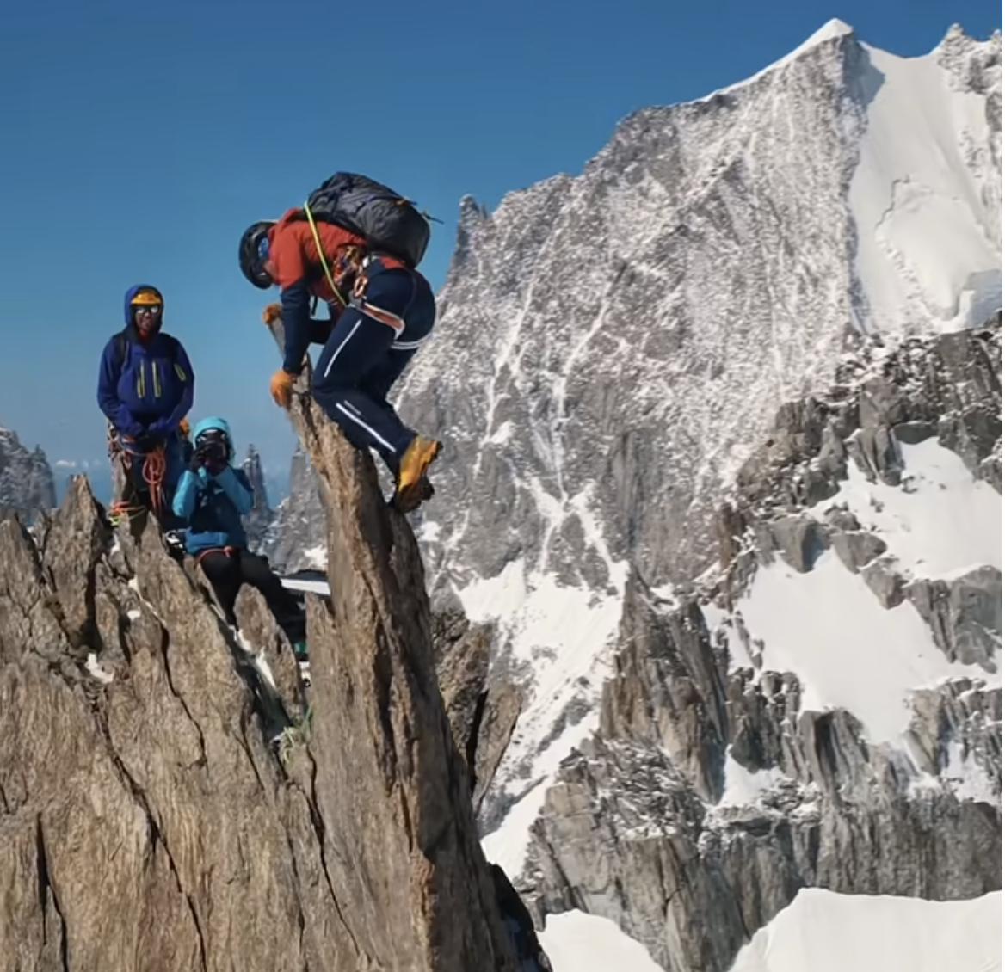
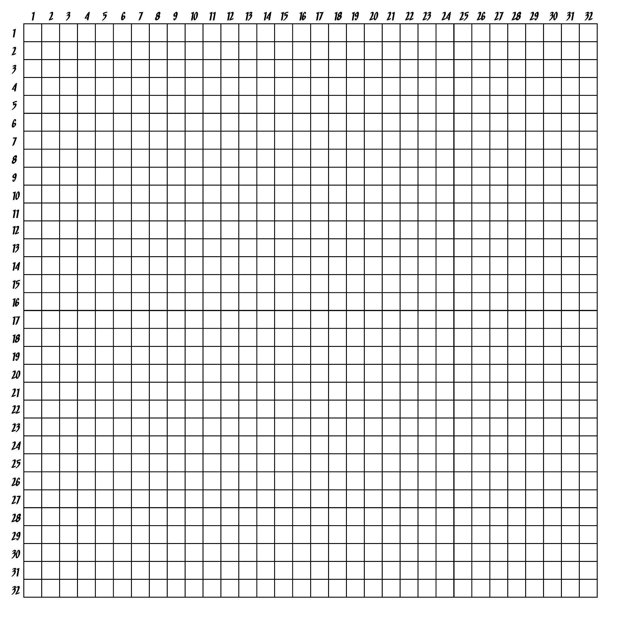
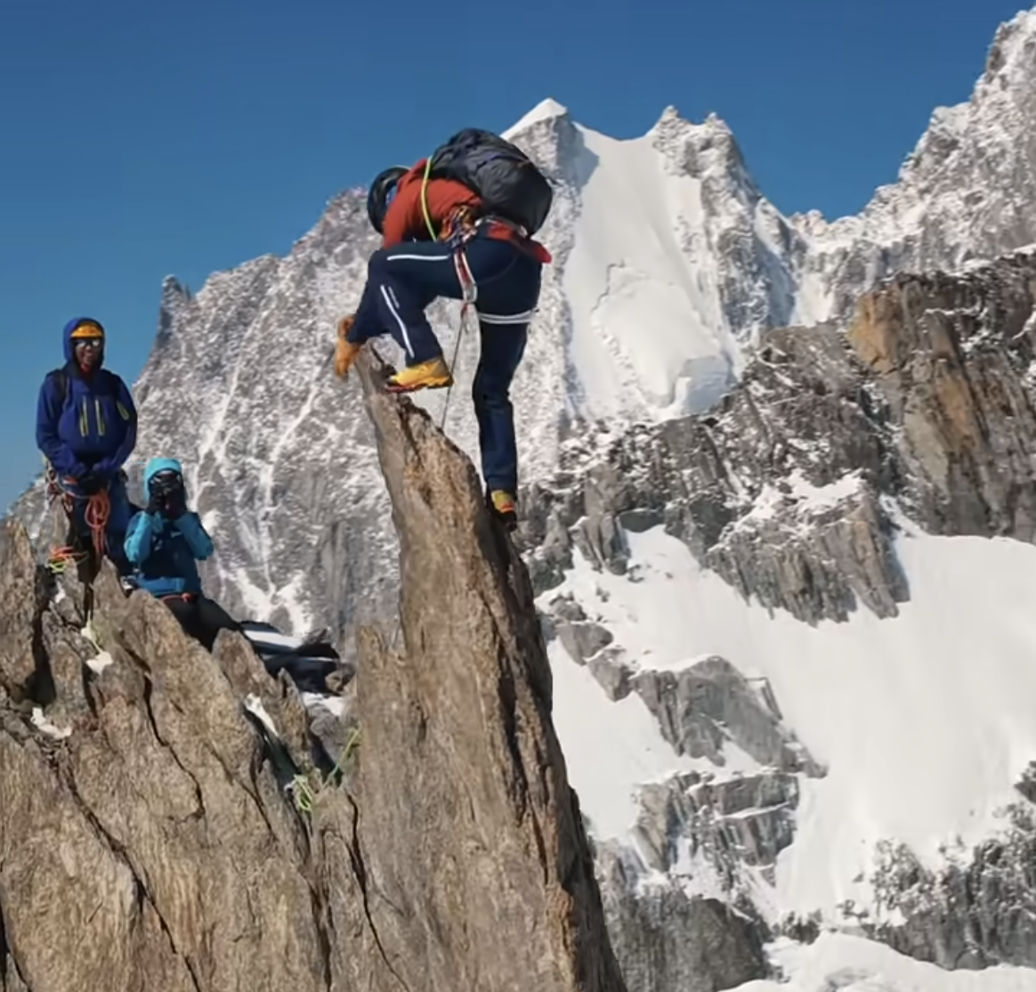

Digital Images Live “On The Grid” of the Camera Sensor
https://www.youtube.com/shorts/vOcqoLGX2jI

Slide 7
We naturally see the world as it is – 3D and dynamic
How do we make computer vision systems that do too?

Slide 8
Why “off the grid”?
Efficiency!
The right inductive bias for vision
Especially for video
https://www.youtube.com/shorts/vOcqoLGX2jI

Slide 9
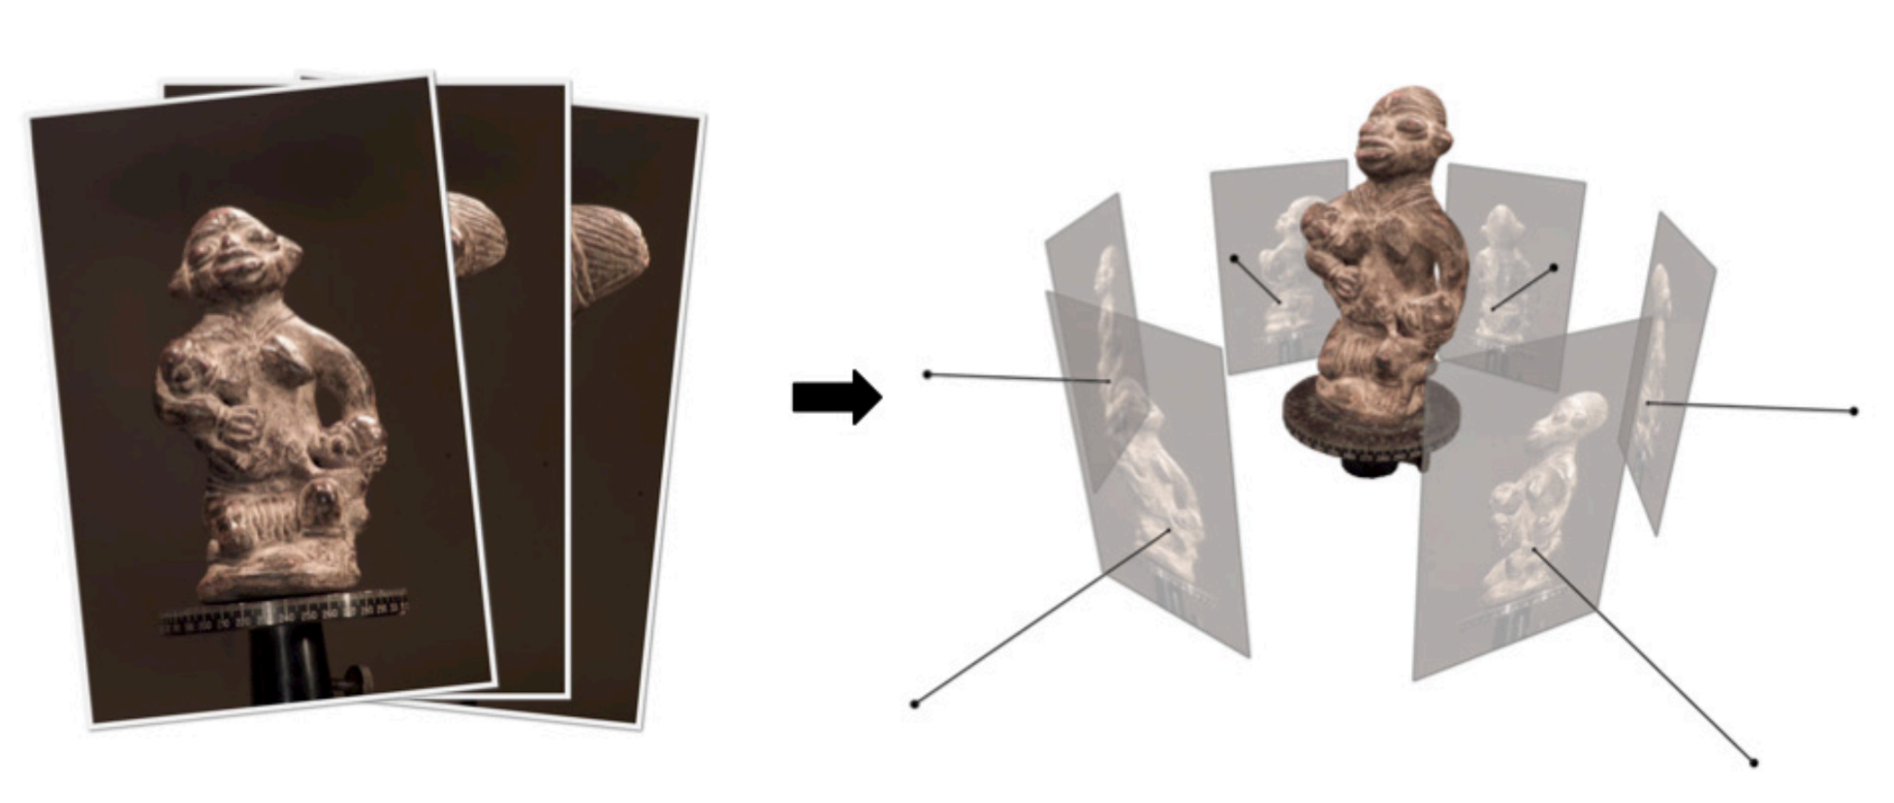
Aside: 3D Reconstruction
A large successful field, but not deep-learning-native
Image from Furukawa & Hernández

Slide 10

ConvNets Operate on the Grid
How do we take them “off the grid”?
https://commons.wikimedia.org/wiki/File:Typical_cnn.png

Slide 11
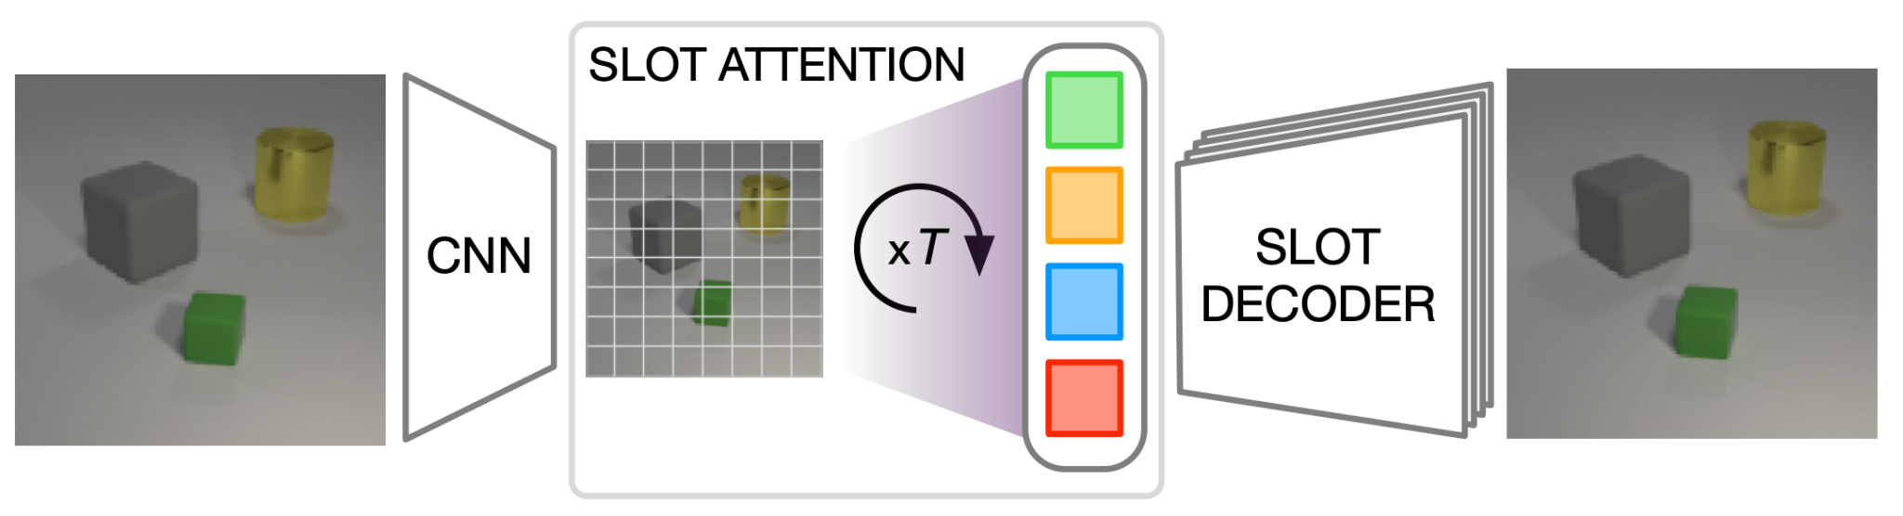
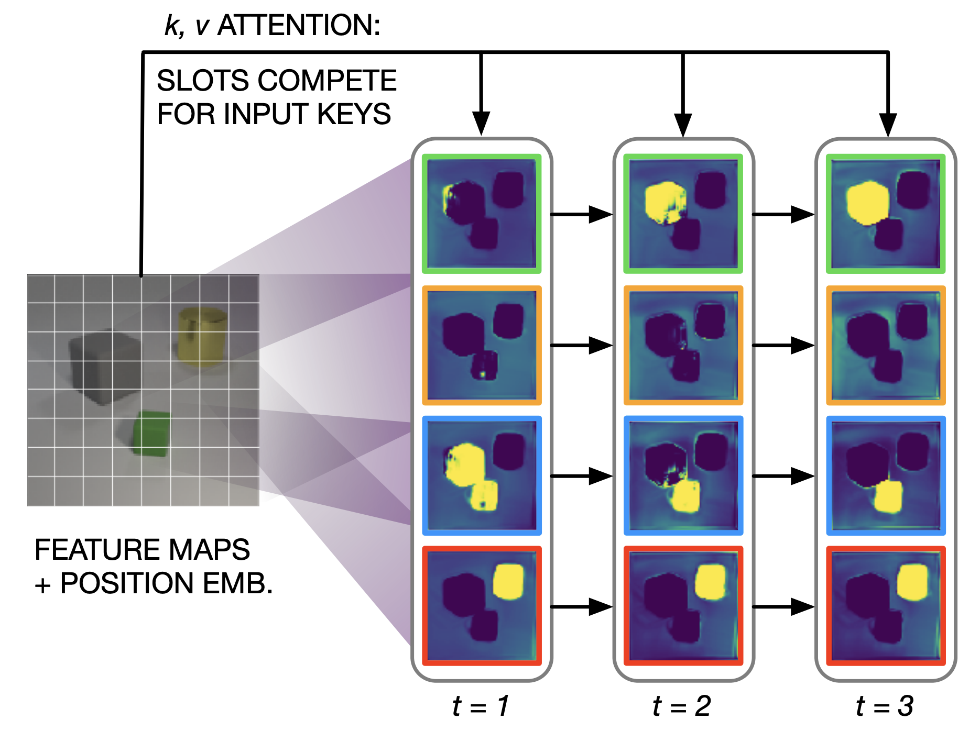
Take 1: Slot Attention
Task: map feature maps of a convolutional model to a set
Approach: Iterative “transposed” attention of K “slots” over the feature maps (~learned soft k-means)
Applications: unsupervised object discovery, set prediction
Locatello et al., Object-Centric Learning with Slot Attention

Slide 12
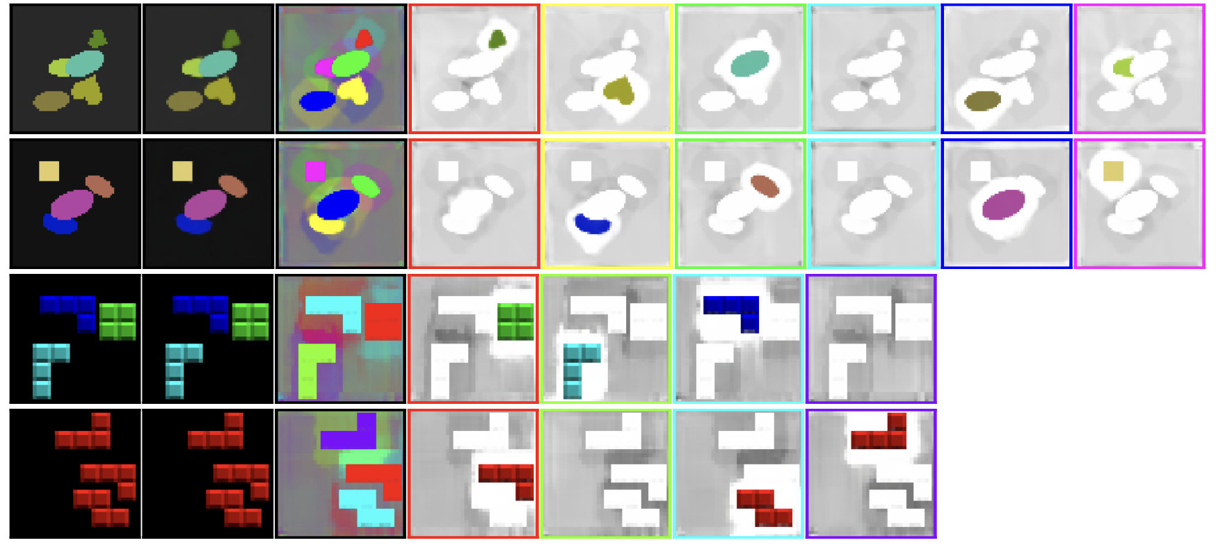
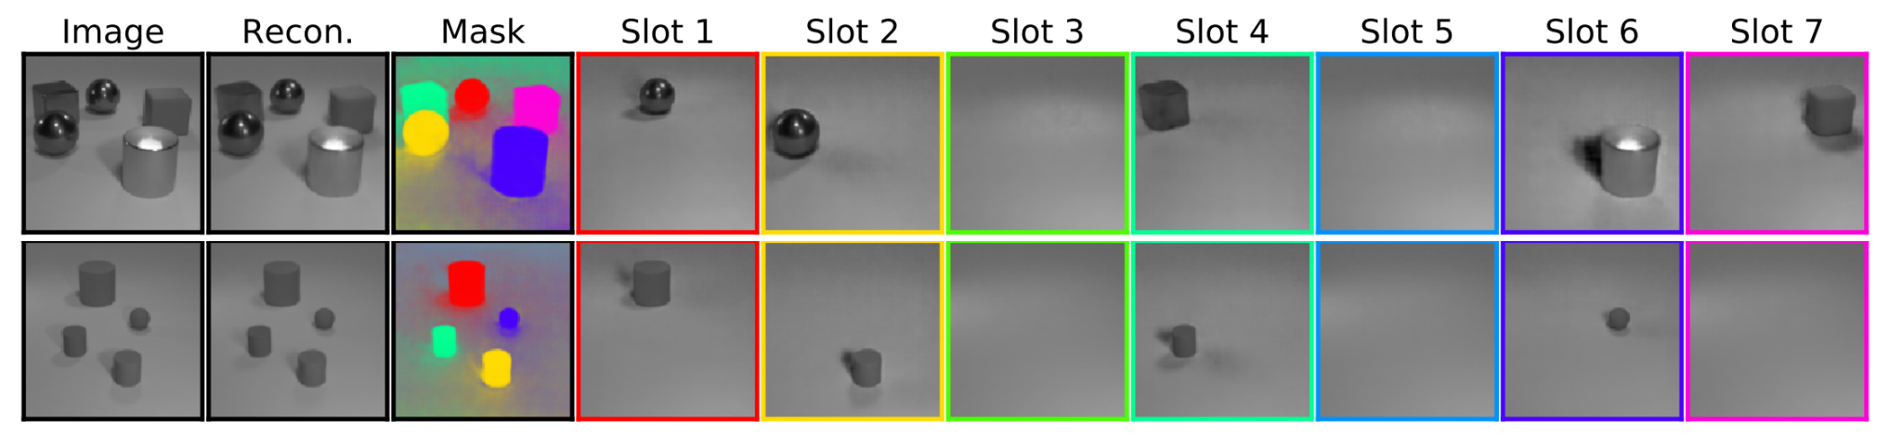
Slot Attention
Works well on simple synthetic tasks
But does not scale to the real world
How do we make a scalable “off-the-grid” model?
Locatello et al., Object-Centric Learning with Slot Attention

Slide 13
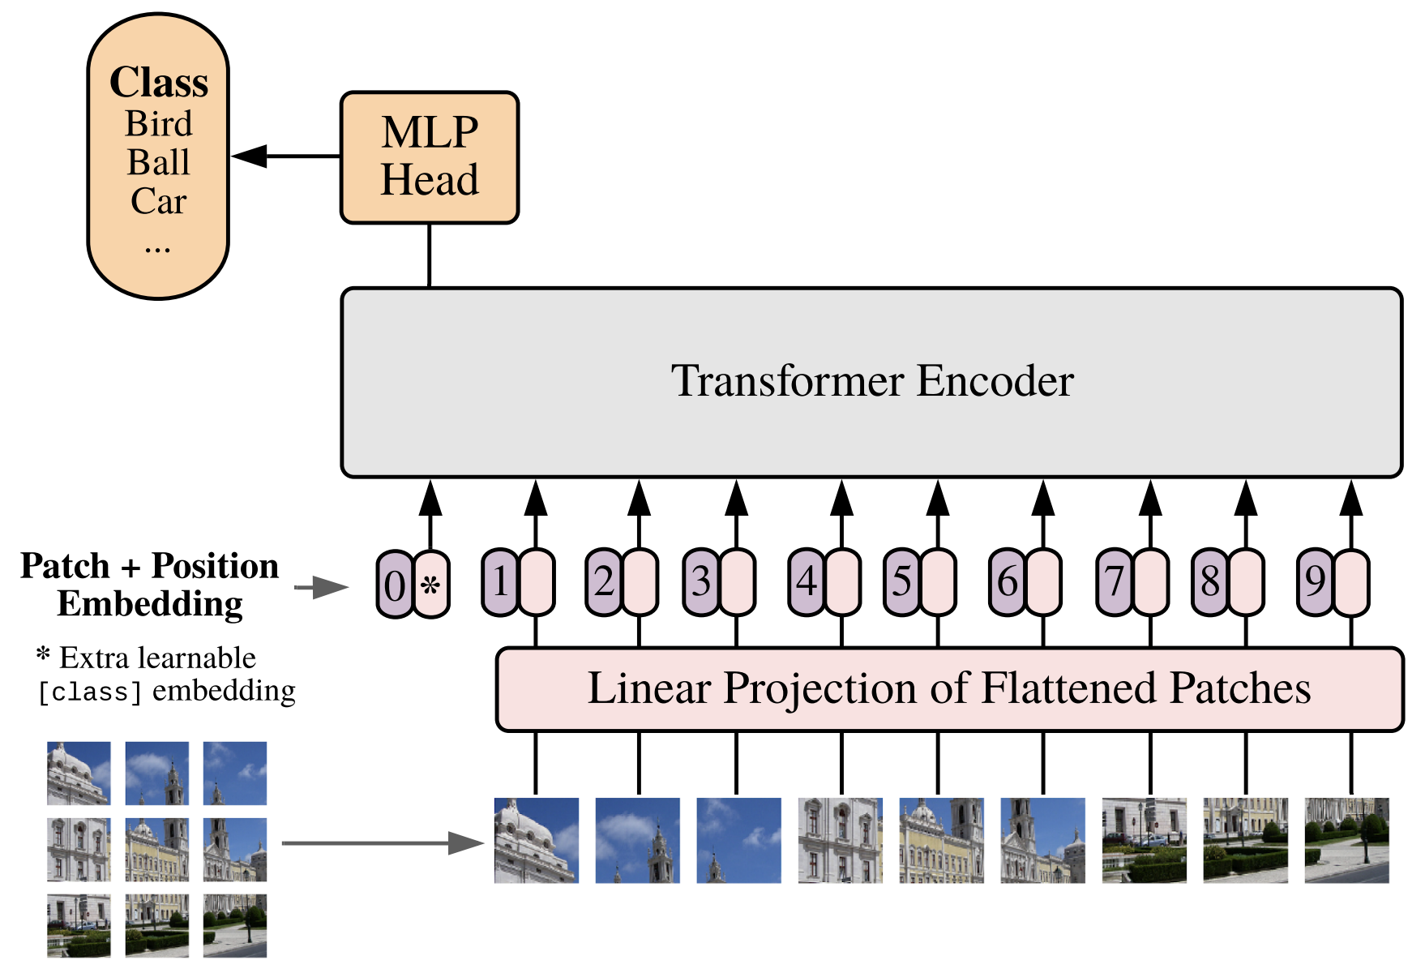
Take 2: Vision Transformers
ConvNets operate “on the grid” – local 2D processing
What operates “off the grid”? Transformers!
Let’s try applying a transformer to vision tasks instead of a ConvNet
Dosovitskiy et al., An Image is Worth 16x16 Words: Transformers for Image Recognition at Scale

Slide 14
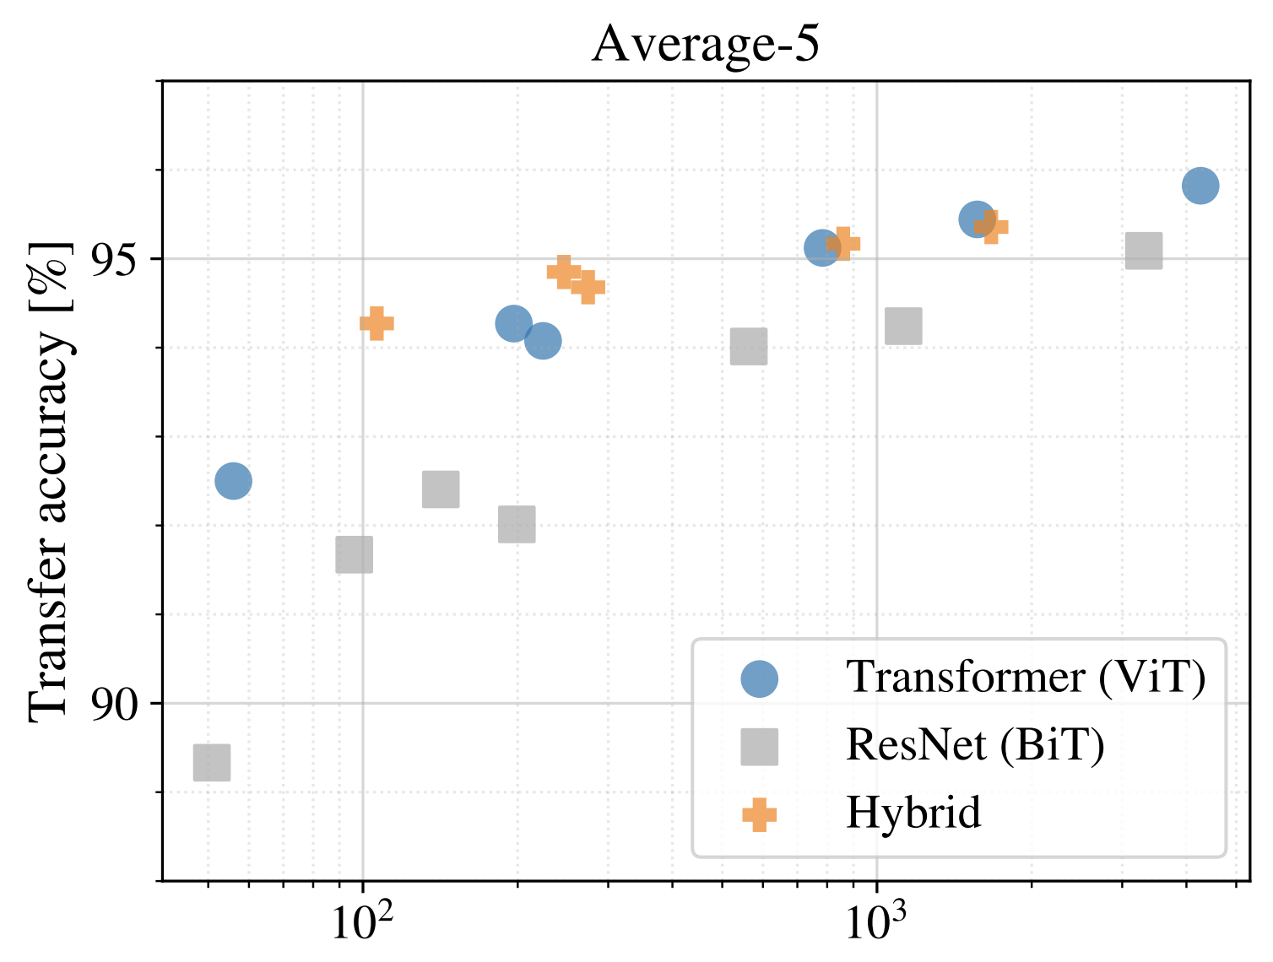
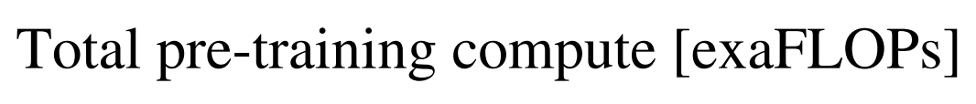
Vision Transformers
Average accuracy on 5 classification tasks
Transformers scale better than ResNets with lots of compute
“Hybrids” even better for smaller amounts of compute
Dosovitskiy et al., An Image is Worth 16x16 Words: Transformers for Image Recognition at Scale

Slide 15
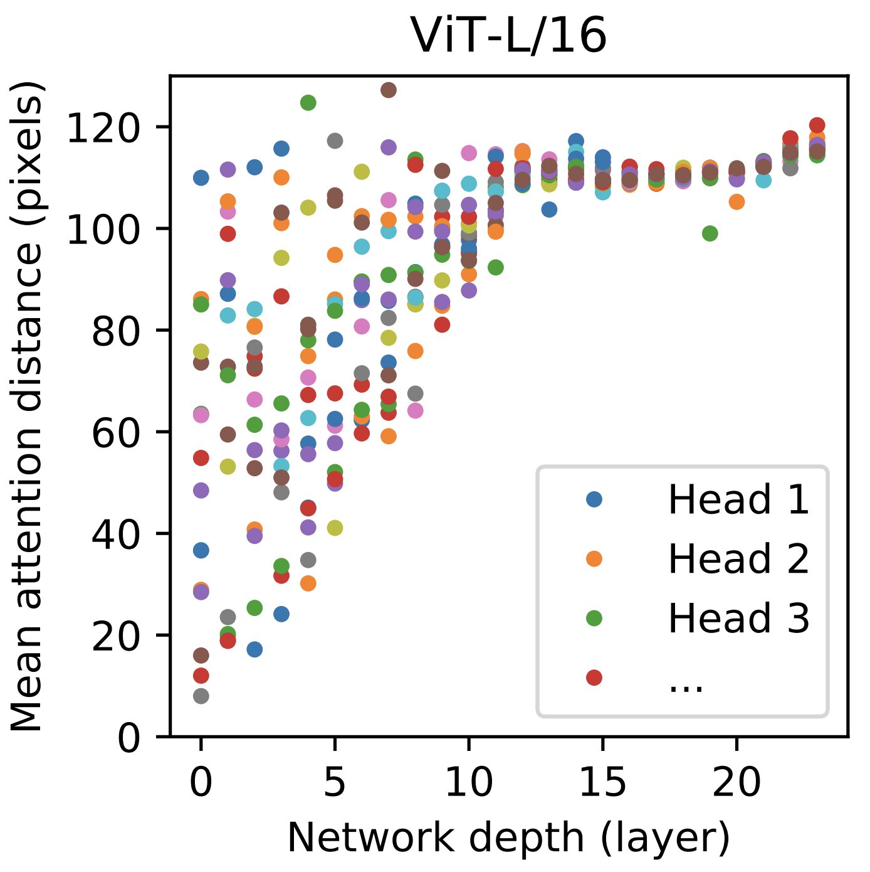
Vision Transformers
Distribution of “attention distance” over layers
In early layers – both local and global attention heads
In latter layers – only global
While transformers themselves are “grid”-agnostic, the representation in ViTs is still “on the grid” (patches)
Dosovitskiy et al., An Image is Worth 16x16 Words: Transformers for Image Recognition at Scale

Slide 16
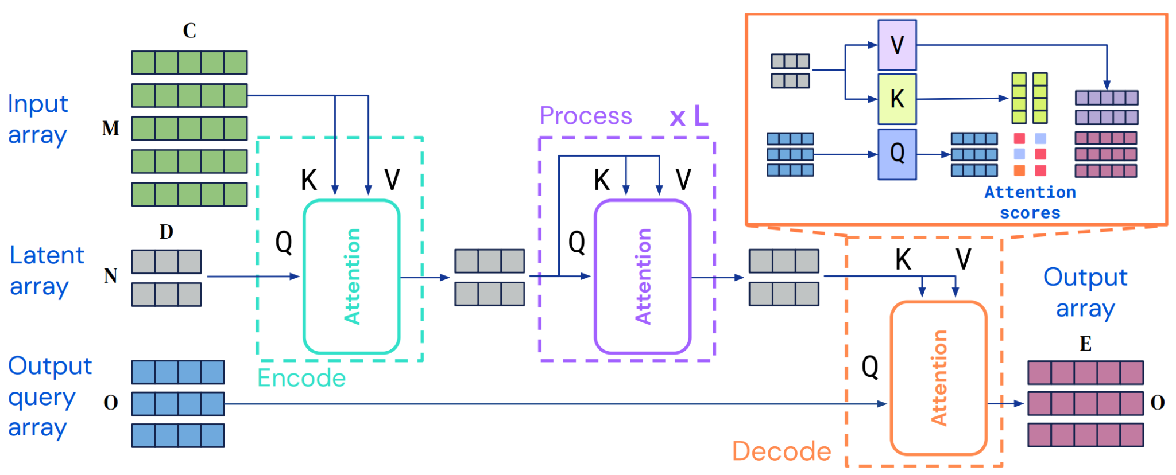
Honorable mention: Perceiver and Perceiver IO
“Off the grid” representation and processing
Works well on many vision tasks
Downside: worse in terms of the compute/performance tradeoff
Jaegle et al., Perceiver: General Perception with Iterative Attention
Jaegle et al., Perceiver IO: A General Architecture for Structured Inputs & Outputs

Slide 17
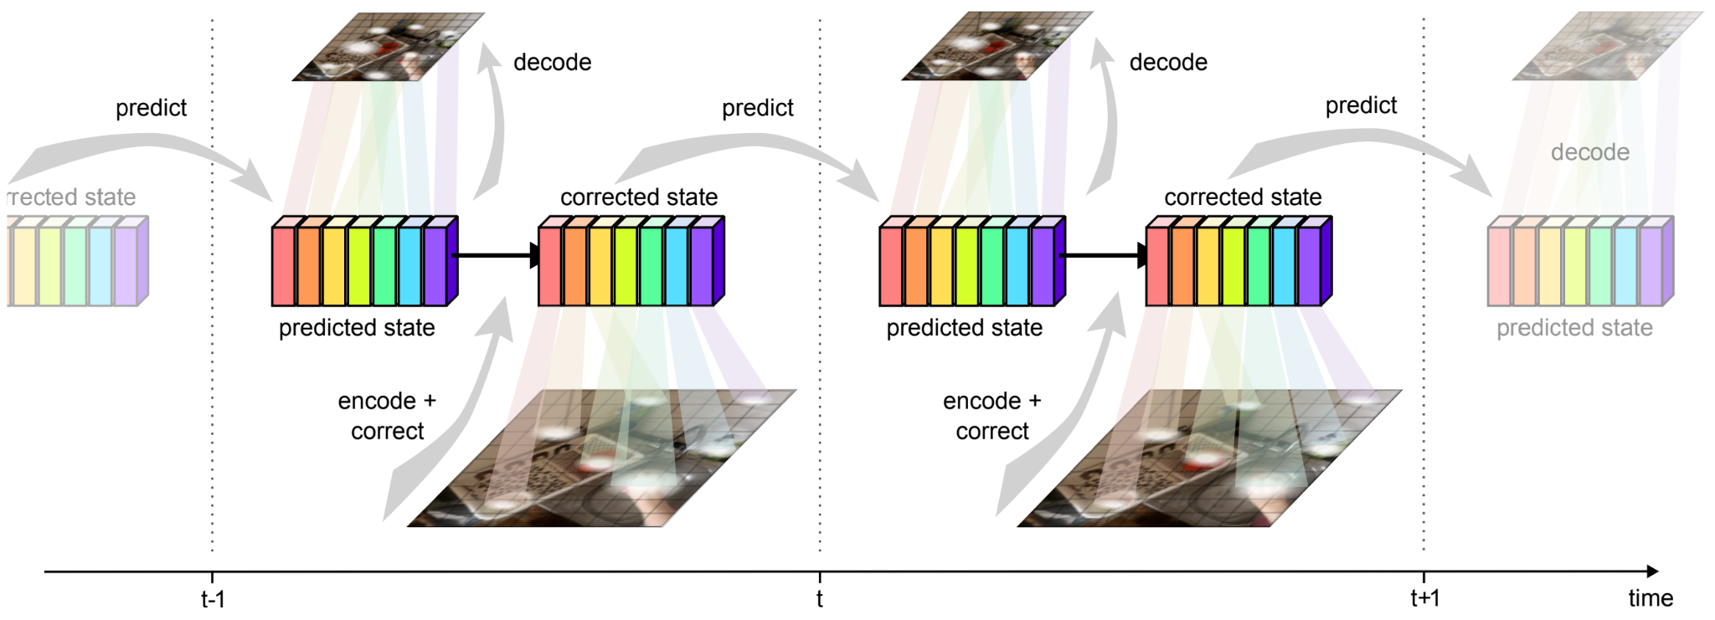
Take 3: MooG – Off-the-Grid for Video
Slot Attention meets Vision Transformers and goes video
Steenkiste et al., Moving Off-the-Grid: Scene-Grounded Video Representations

Slide 18
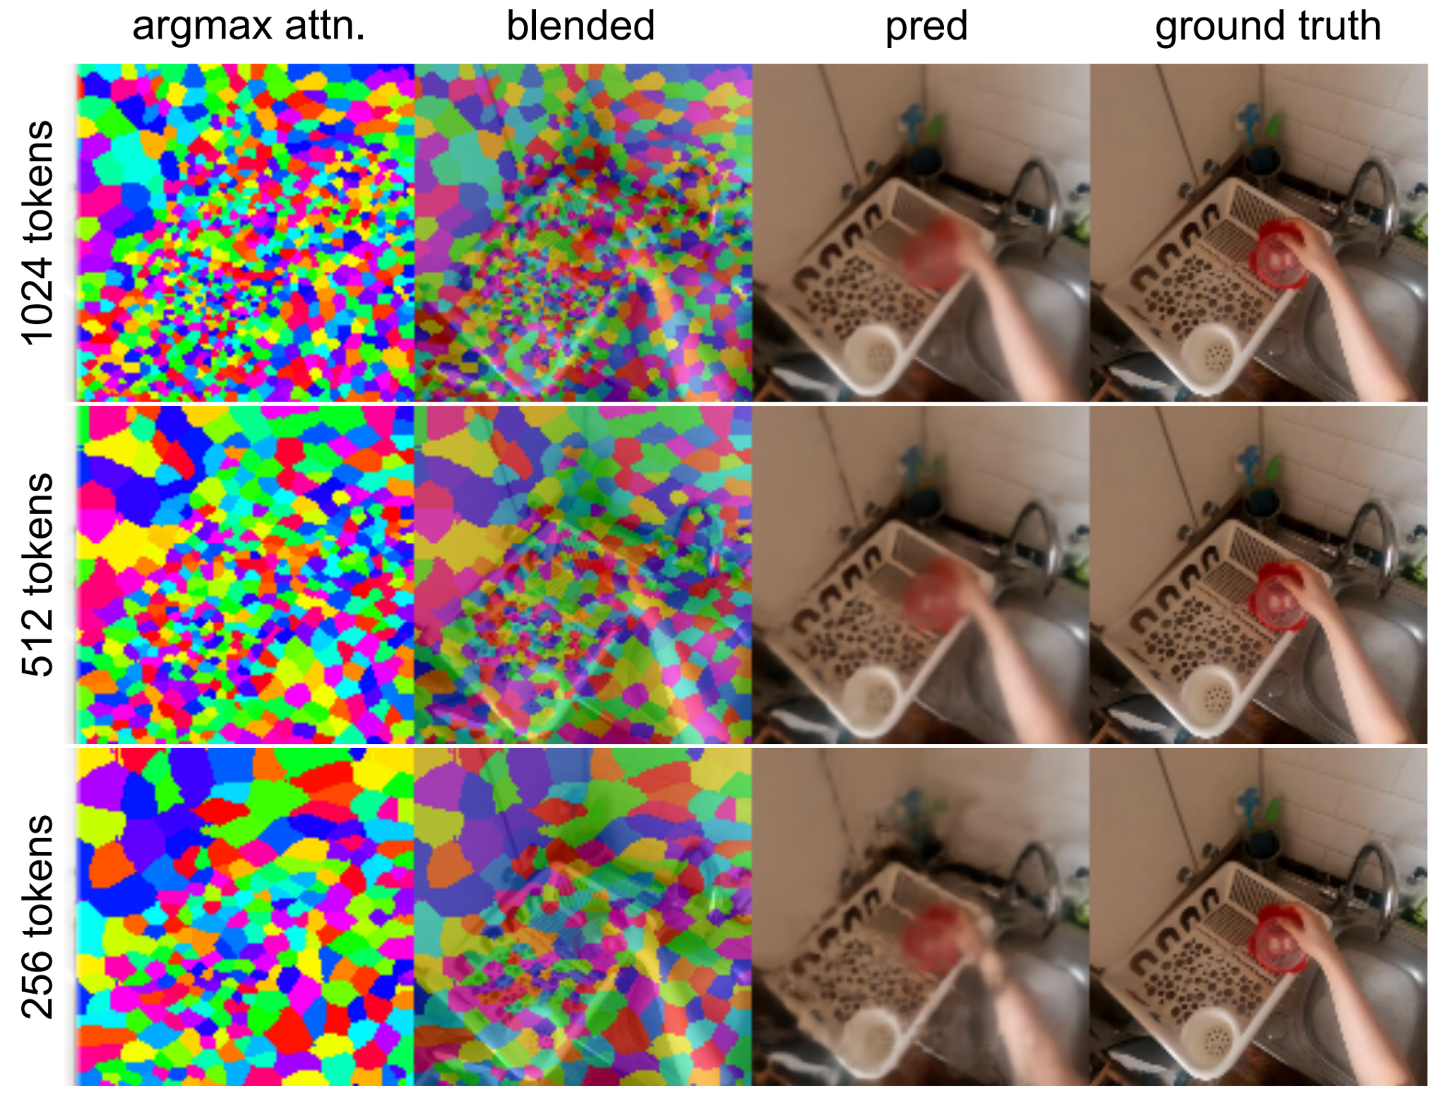
MooG: Off-the-Grid for Video
Learns variable token size depending on the local complexity
Steenkiste et al., Moving Off-the-Grid: Scene-Grounded Video Representations

Slide 19


MooG: Off-the-Grid for Video
Tokens are “off the grid” and rather connected to the scene!
Steenkiste et al., Moving Off-the-Grid: Scene-Grounded Video Representations

Slide 20

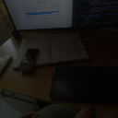
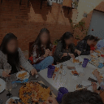
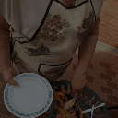


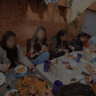

MooG: Off-the-Grid for Video
Tokens are “off the grid” and rather connected to the scene!
Steenkiste et al., Moving Off-the-Grid: Scene-Grounded Video Representations

Slide 21
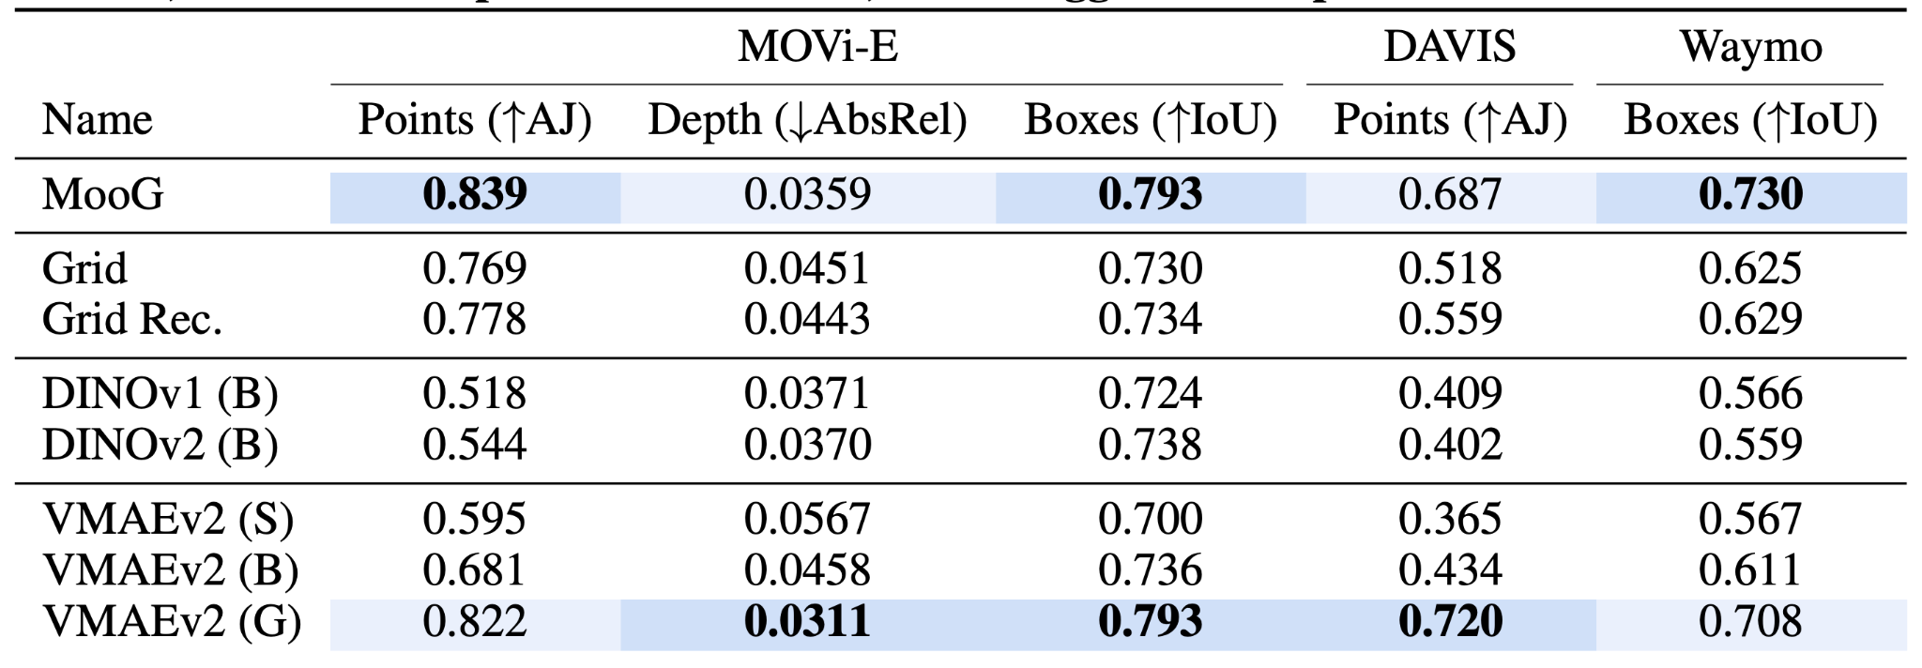
MooG: Off-the-Grid for Video
Works pretty well on downstream tasks too
This is using frozen representation from the model
Note that MooG has 35M params, while VMAEv2 S/B/G – 20M/80M/1000M
Steenkiste et al., Moving Off-the-Grid: Scene-Grounded Video Representations

Slide 22
Summary
 | Off-the-grid representation | Off-the-grid processing | Scalable
Slot Attention | yes | no | no
Vision Transformer | no | yes | yes
Perceiver (IO) | yes | yes | maybe
MooG | yes | yes | maybe
Honorable mentions:
RIN (Jabri et al.)
FIT (Chen, Li)
AdaTape, Registers
Gaussian Splatting
GLOM (Hinton)
…
Good progress, but still no “bulletproof” scalable off-the-grid model
Difficult to imagine that transformers are “the ultimate architecture”
=> we need to keep trying!

Slide 23

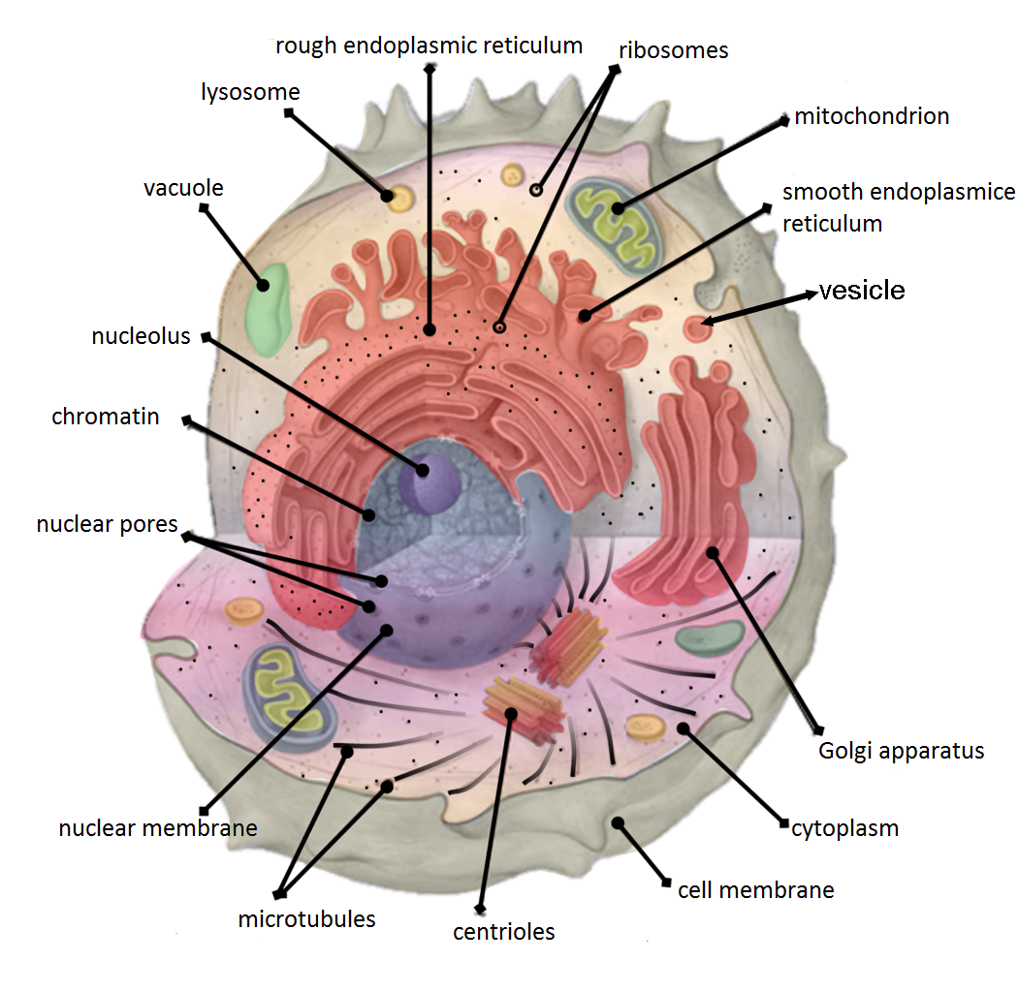
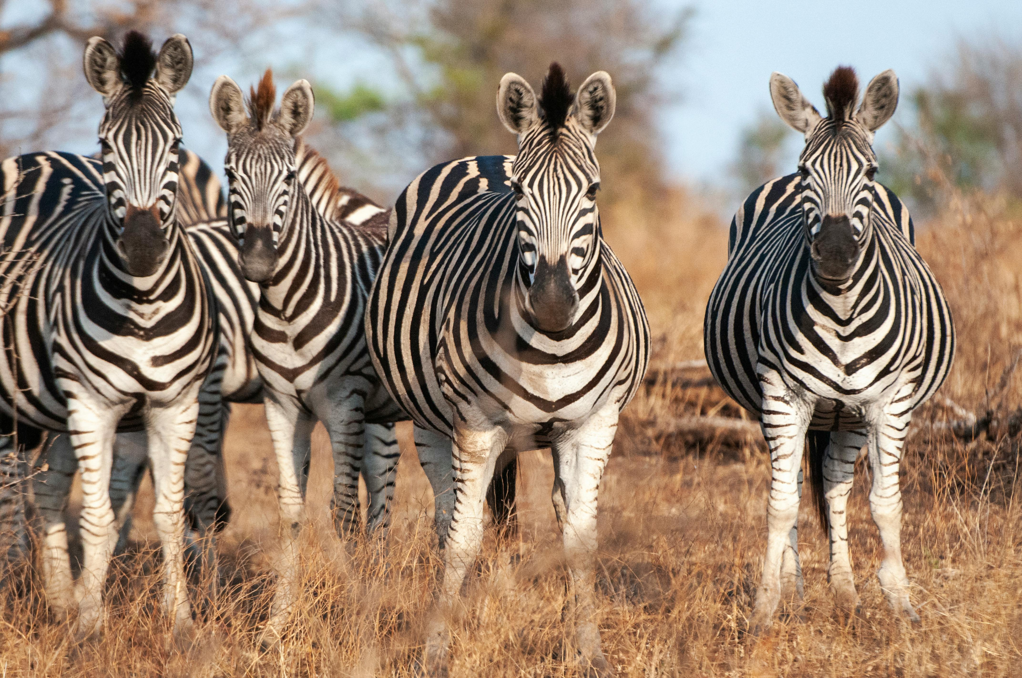
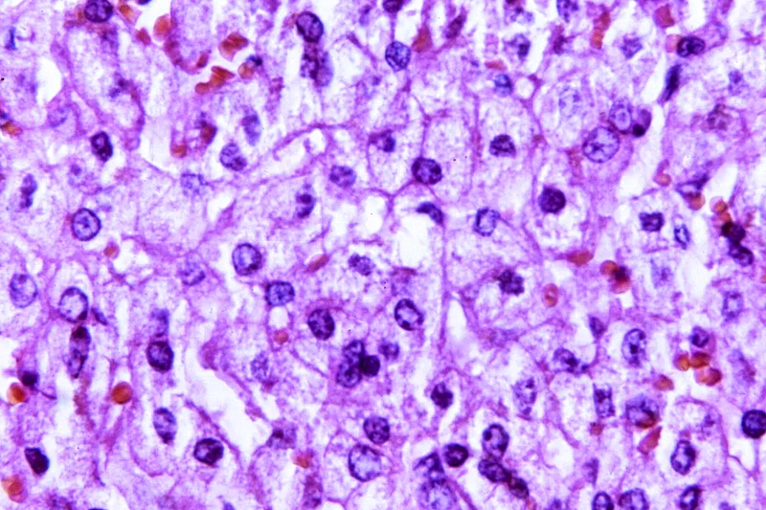
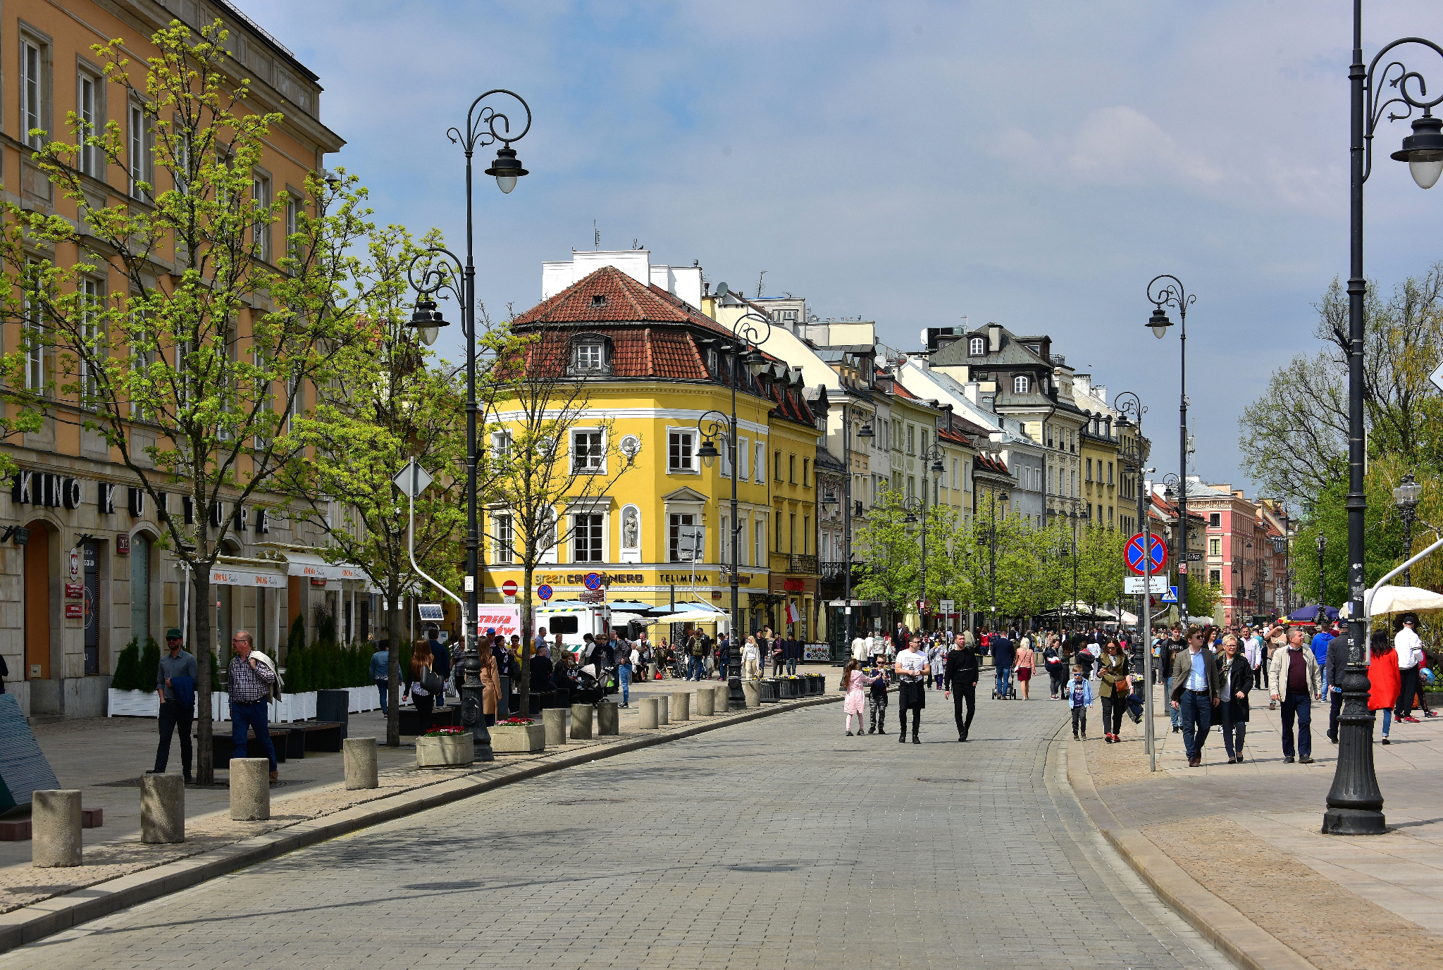
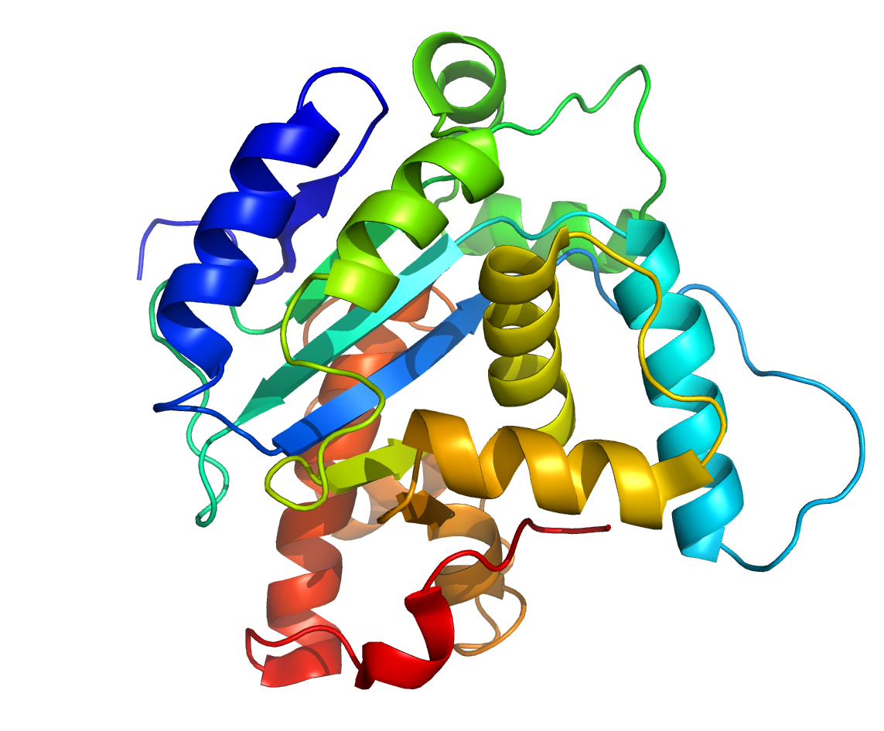

From Pixels
To Nucleotides
???

Slide 24
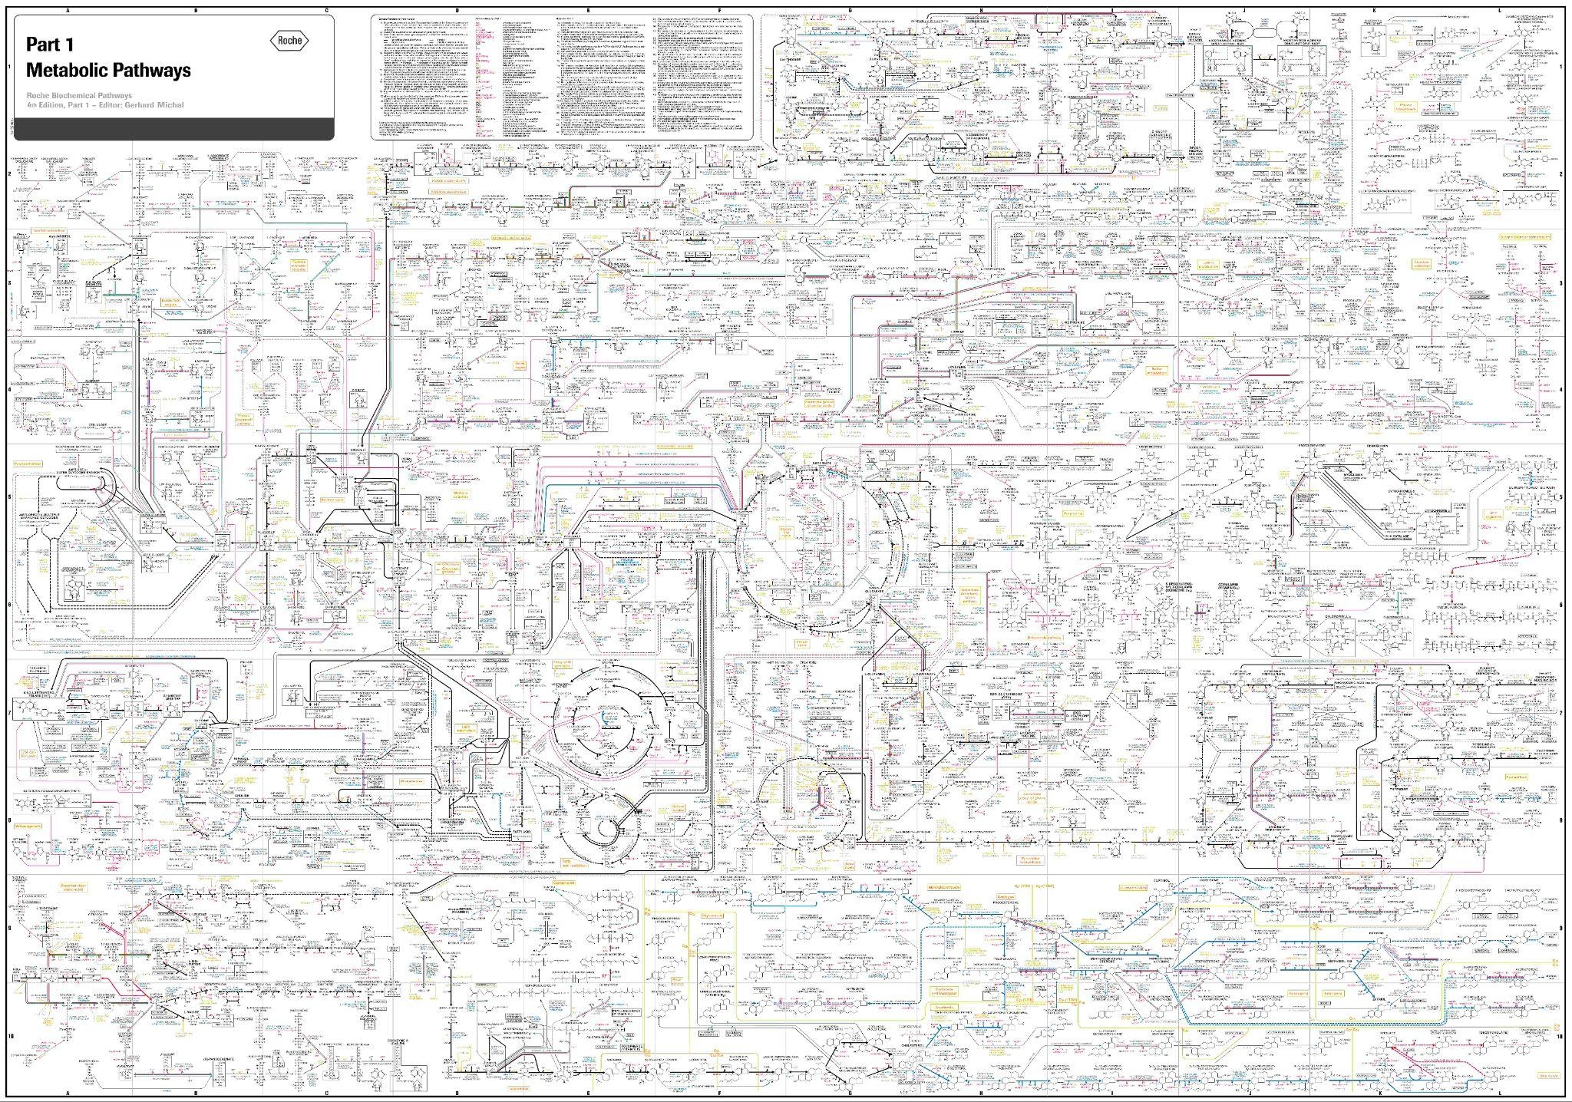
Biology is Complex
Michal et al., Roche, “Metabolic Pathways”

Slide 25
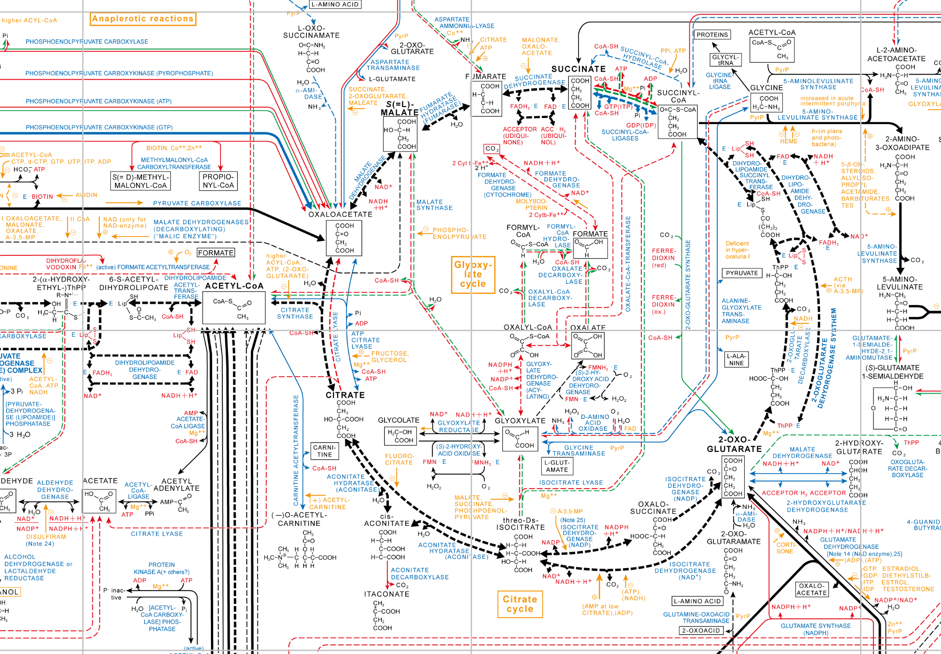
Biology is Very Complex
Michal et al., Roche, “Metabolic Pathways”

Slide 26
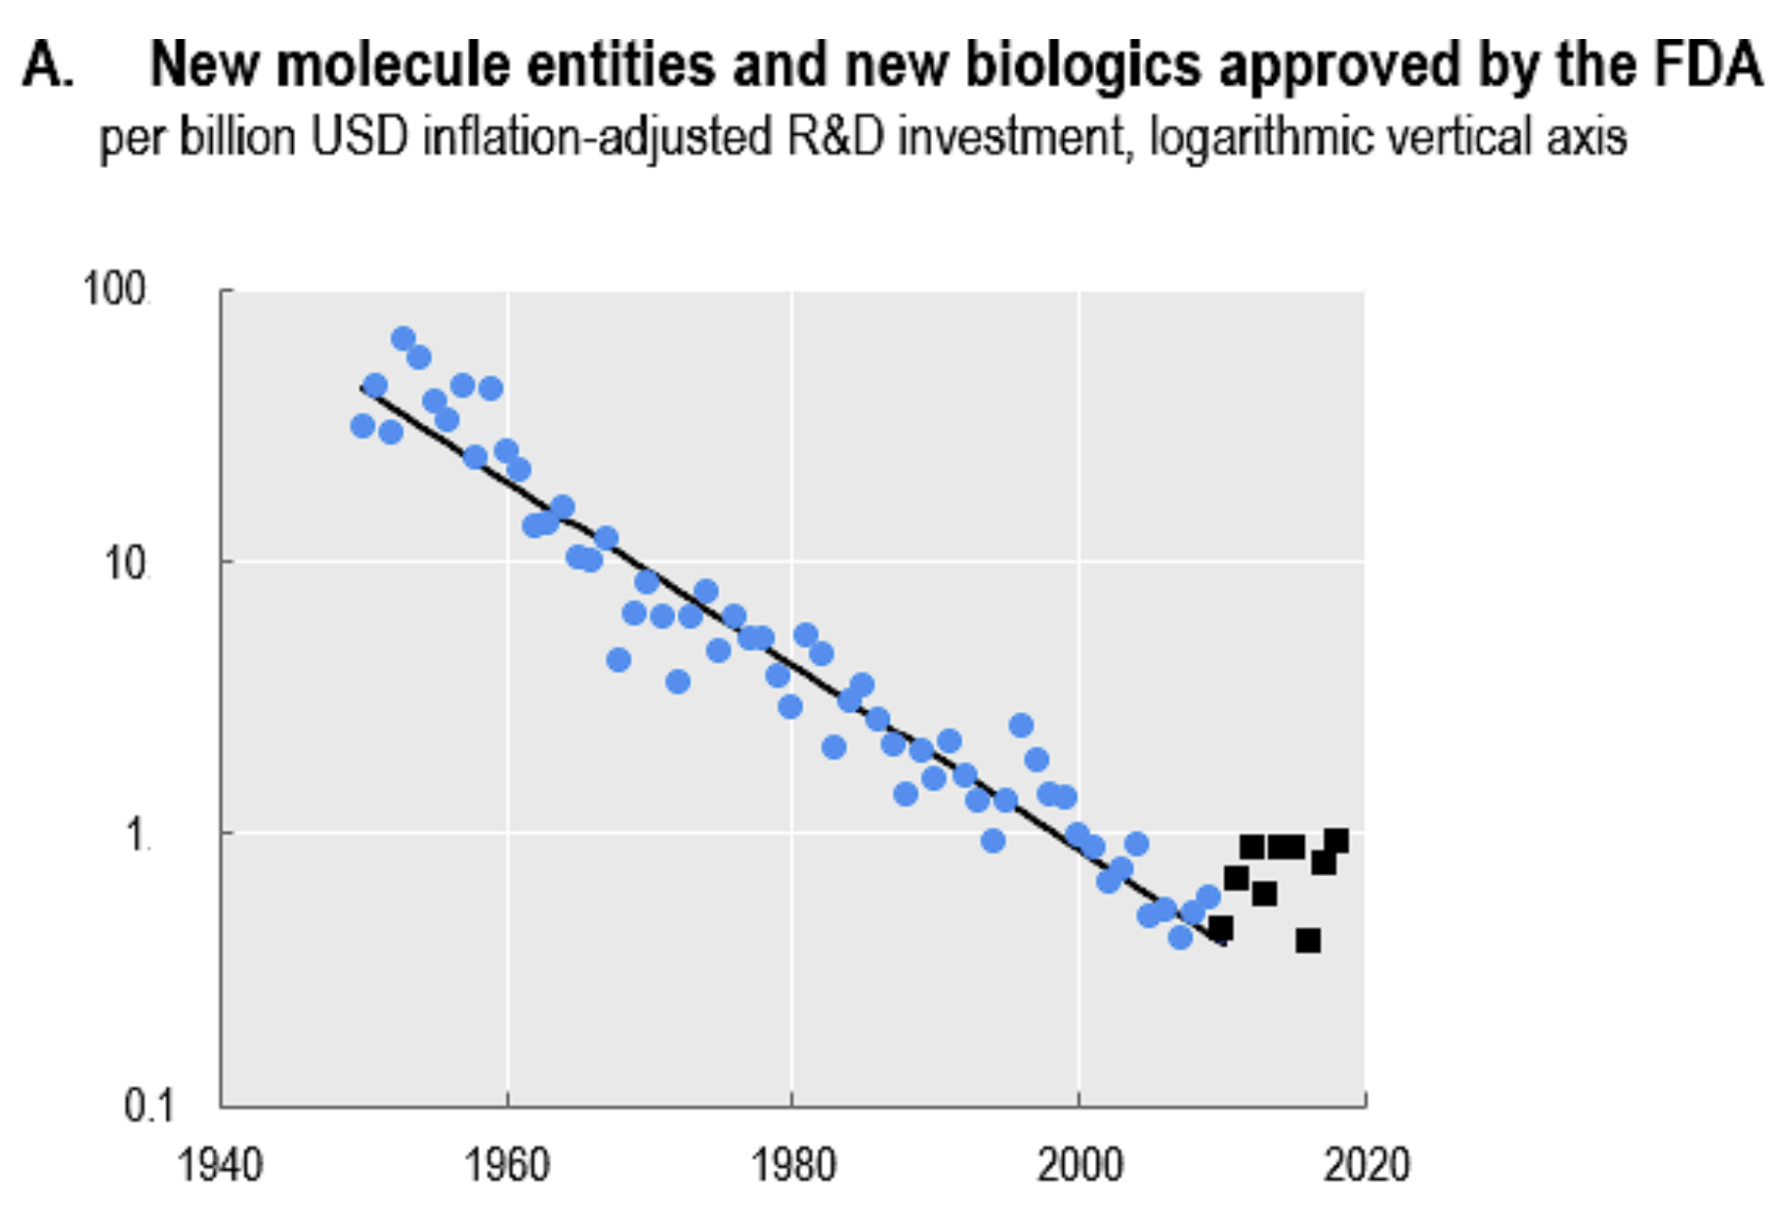
Eroom’s law: Drug Development Gets More Expensive
Scannell et al., Diagnosing the decline in pharmaceutical R&D efficiency
Scannell, Eroom’s Law and the decline in the productivity of biopharmaceutical R&D

Slide 27
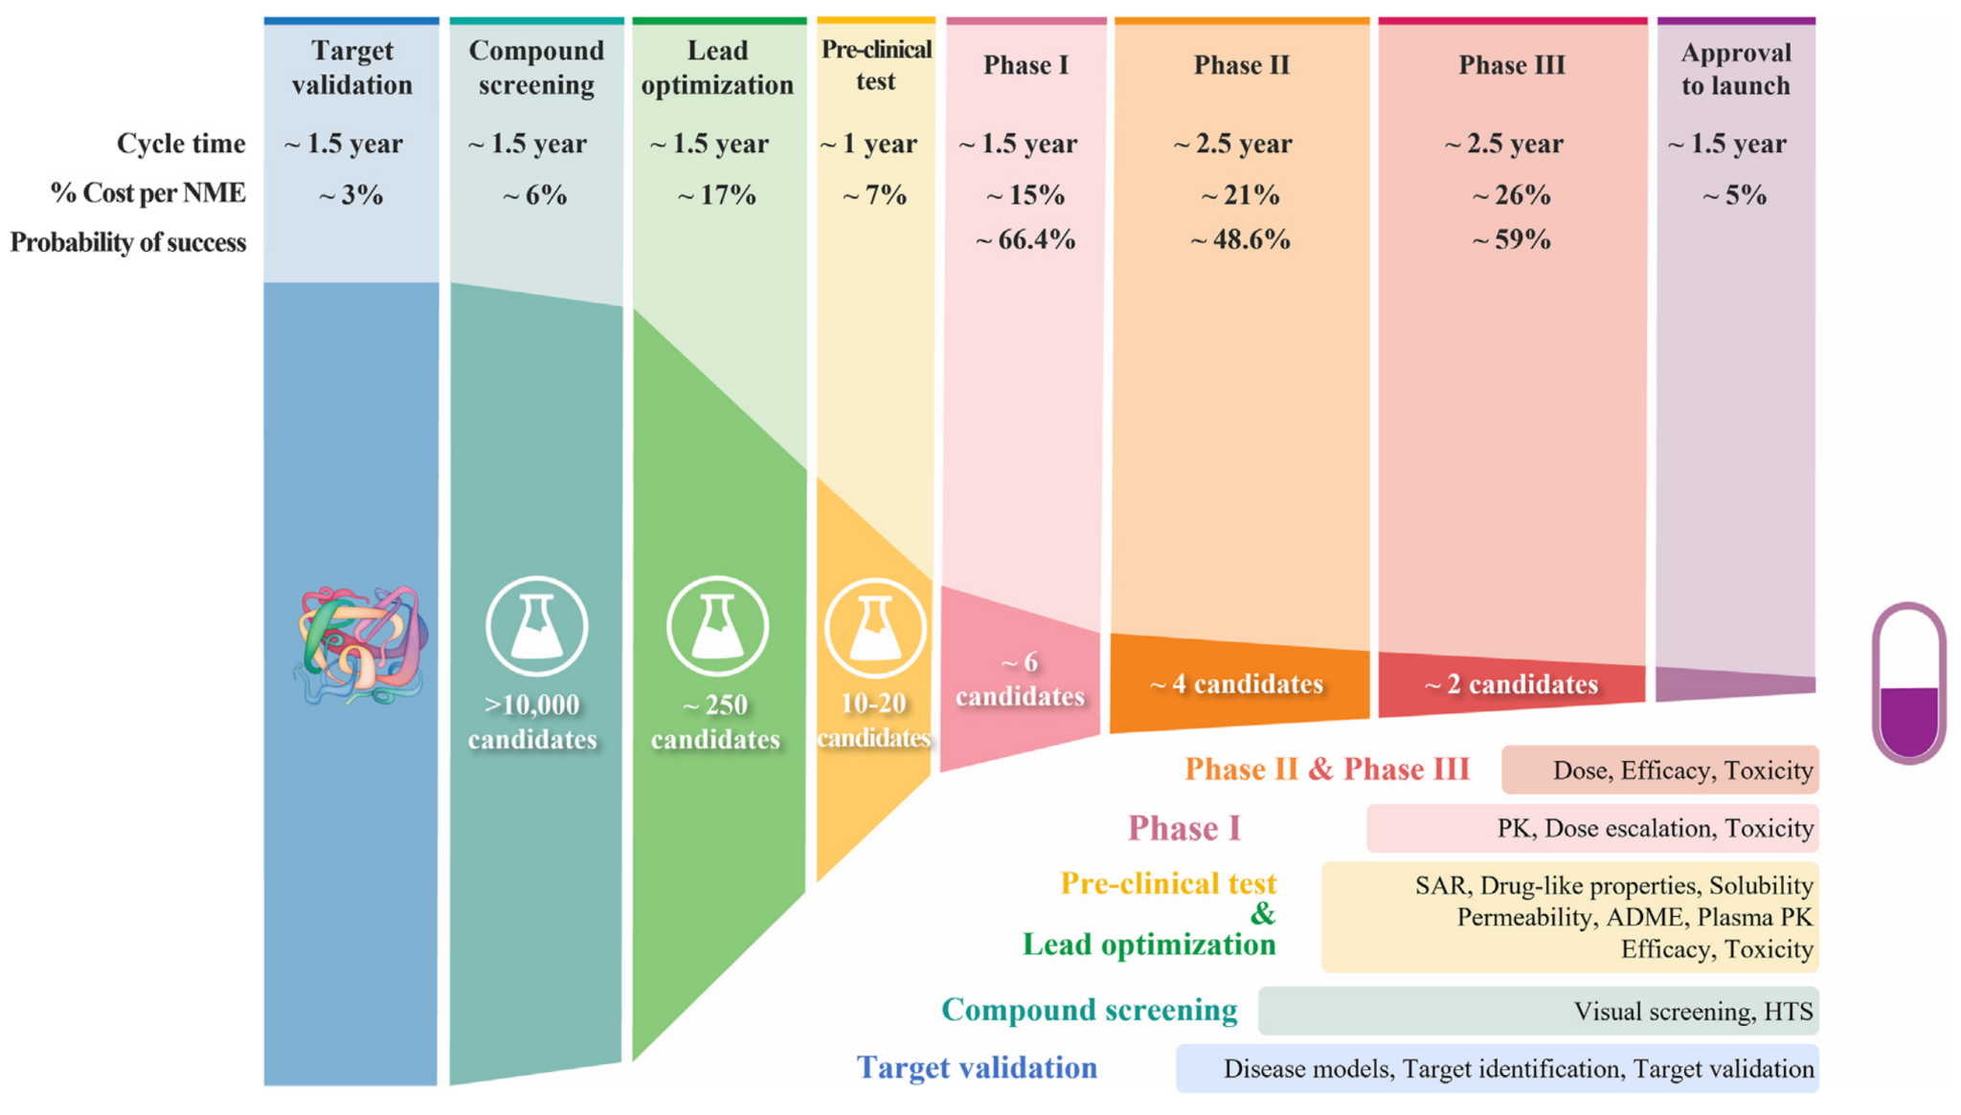
Why So Expensive? Funnel of Drug Development
Sun et al., Why 90% of clinical drug development fails and how to improve it?

Slide 28
ML to the rescue?

Slide 29
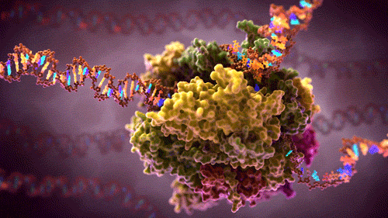
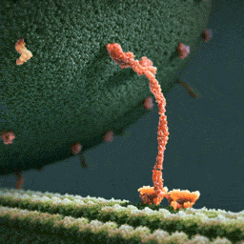
Proteins* make living organisms tick
* There’s increasing evidence that (non-coding) RNA etc are super important too

Slide 30
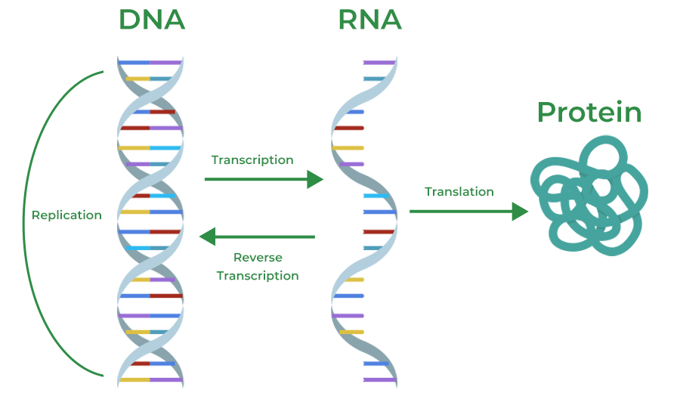
Central dogma of molecular biology
https://www.geeksforgeeks.org/biology/central-dogma-steps-guide/

Slide 31
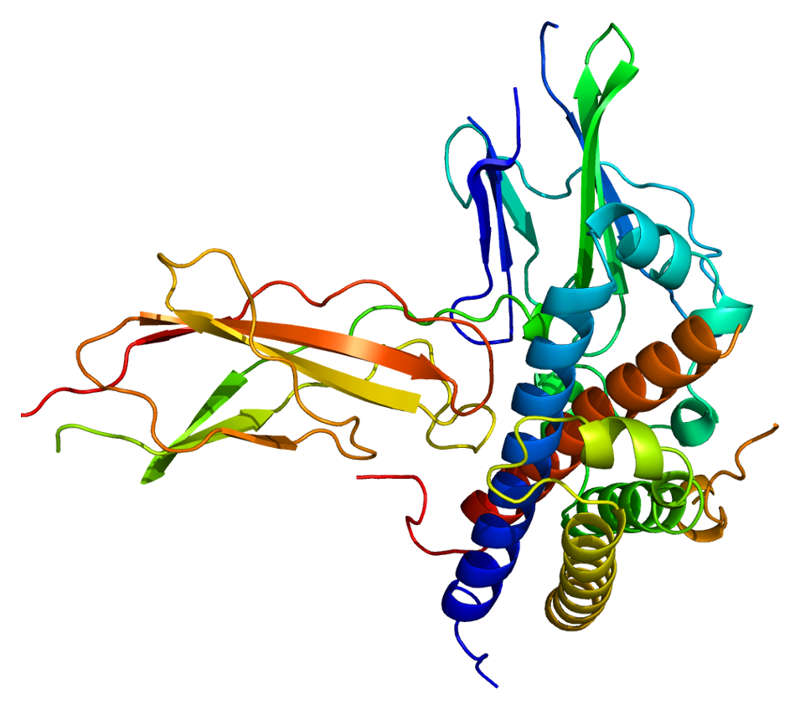
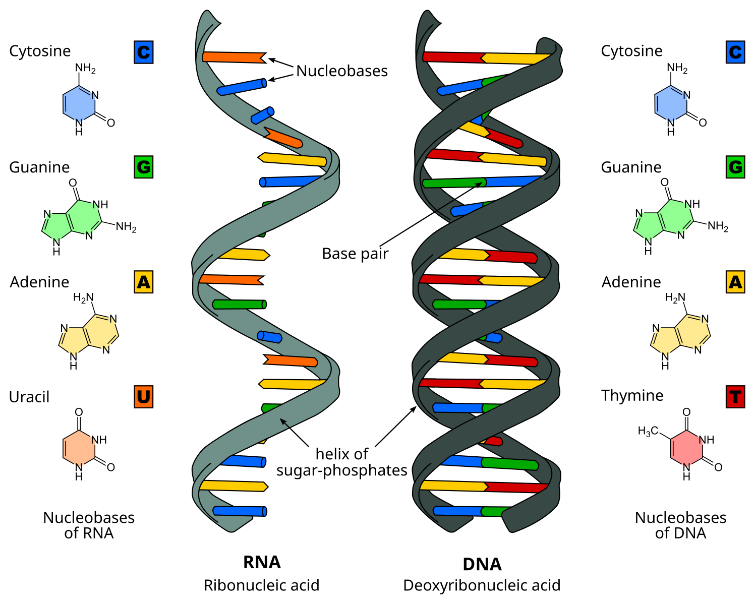
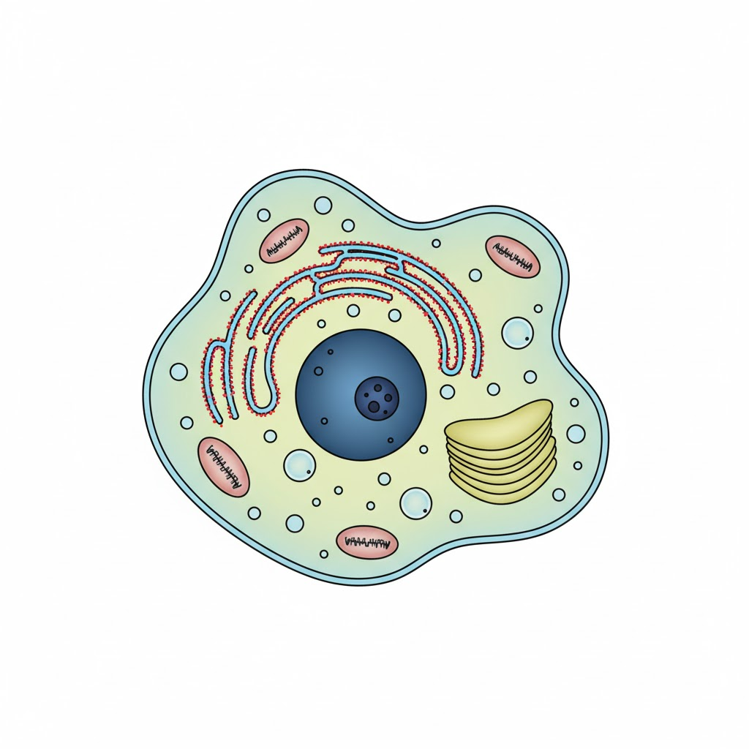
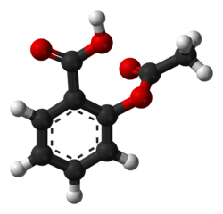
Drug Modalities
Small molecules
Nucleic acids
Proteins
Cells
Biologics
Images from https://commons.wikimedia.org/

Slide 32
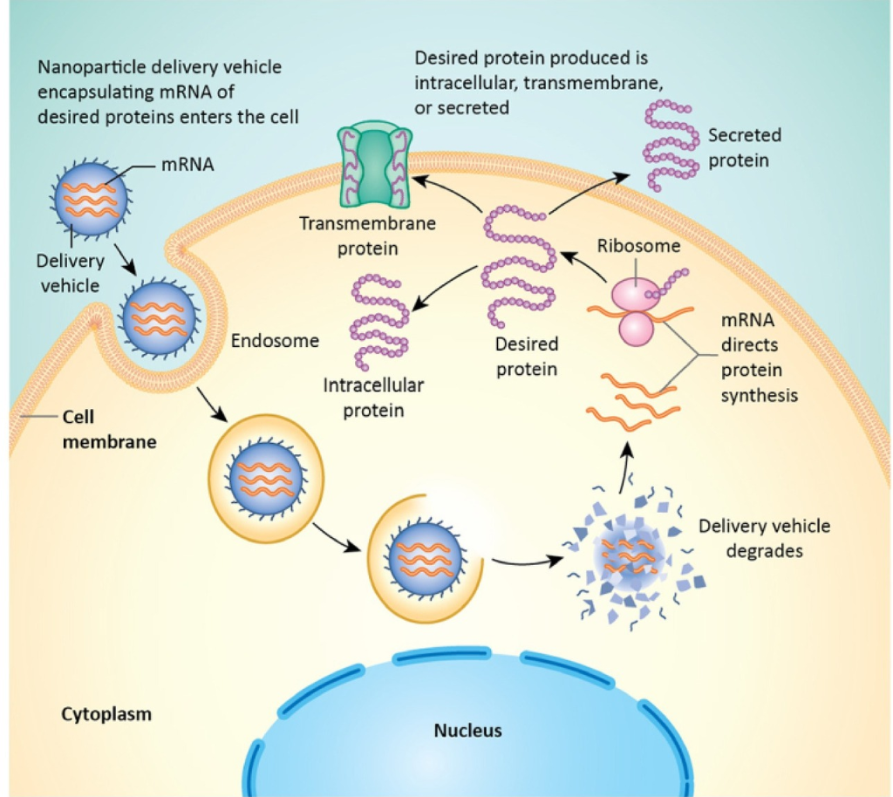
mRNA drugs
Instead of putting proteins into the body, make body produce the proteins itself
Delivered usually in lipid nanoparticles (LNPs)
Bhat et al., mRNA therapeutics: beyond vaccine applications

Slide 33
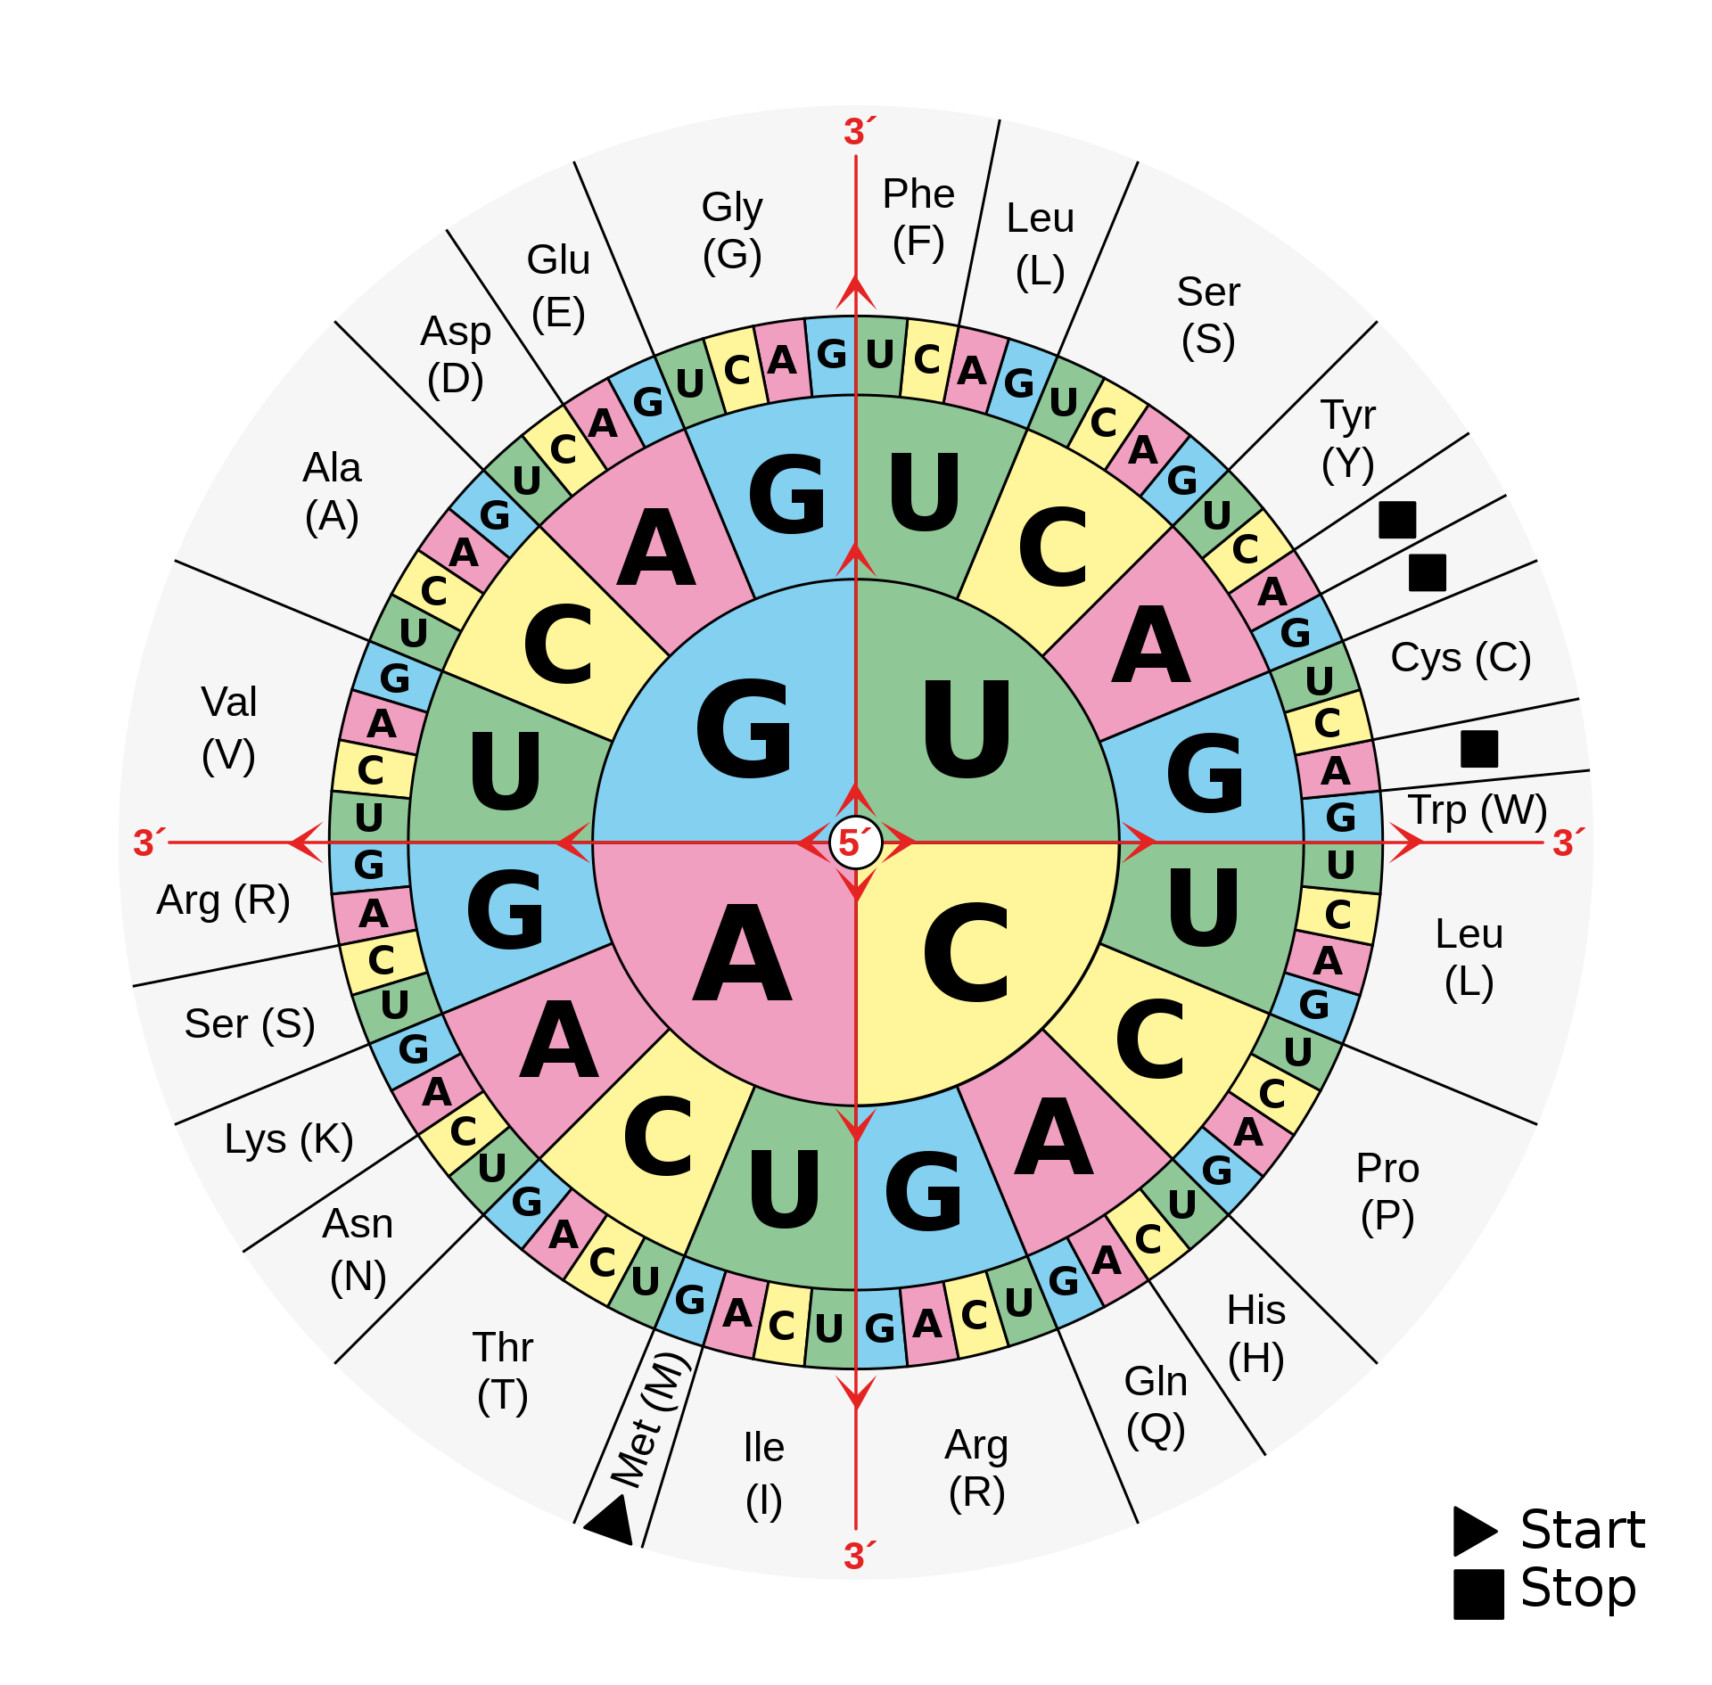
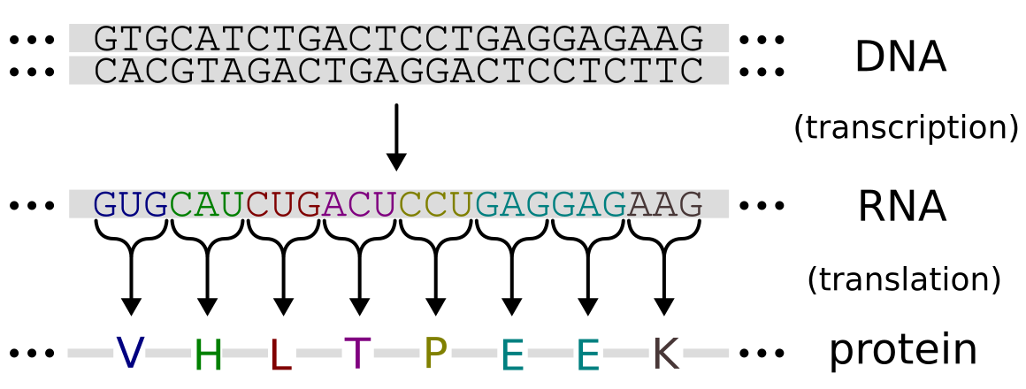
DNA/RNA code for proteins
DNA/RNA: 4 types of nucleotides
Protein: ~22 amino acids
Triplet of nucleotides: 4^3 = 64 options
https://en.wikipedia.org/wiki/DNA_and_RNA_codon_tables#/media/File:Aminoacids_table.svg
https://commons.wikimedia.org/wiki/File:Genetic_code.svg

Slide 34
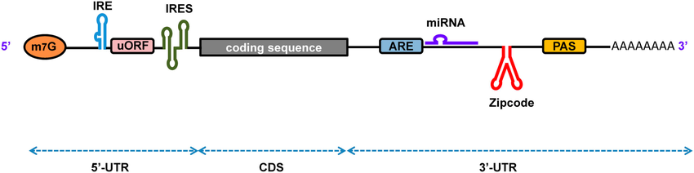
mRNA Design Problem Example: COVID Spike Protein
E.g. COVID spike protein: 1273 amino acids long
Untranslated regions: e.g. 150 + 350 = 500 nucleotides
=> total number of options approx: 4^500 * 3^1273 = *a lot*
Number of nucleotides
Approx number of codon options per amino acid
Ahmed et al., Mining Functional Elements in Messenger RNAs: Overview, Challenges, and Perspectives

Slide 35
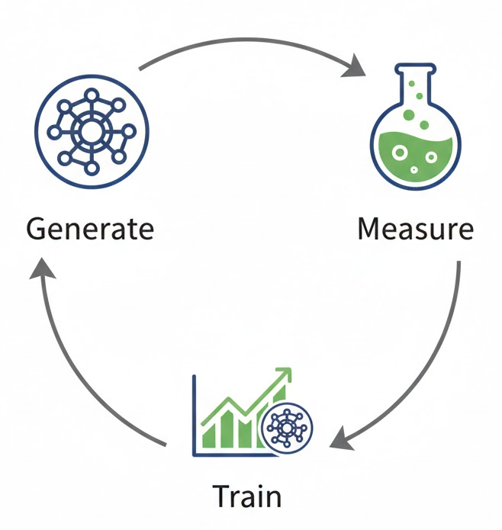
How do we solve it? “Lab in the Loop”

Slide 36

Challenge: Evaluation
Clinical trials
In-vivo non-human primates
In-vivo mice
In-vitro (cells) arrayed
In-vitro (cells) pooled
In-silico (computational)
Cost
Scale

Slide 37
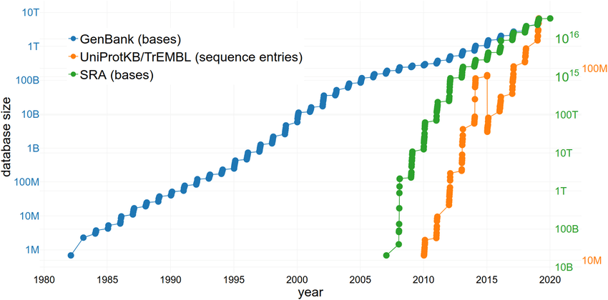
Challenge: Training data
Lots of publicly available genomic data (DNA, RNA, sequencing, proteins)
But fairly little, and scattered, measurements speaking to the properties
Sielemann et al., The Reuse of Public Datasets in the Life Sciences: Potential Risks and Rewards

Slide 38
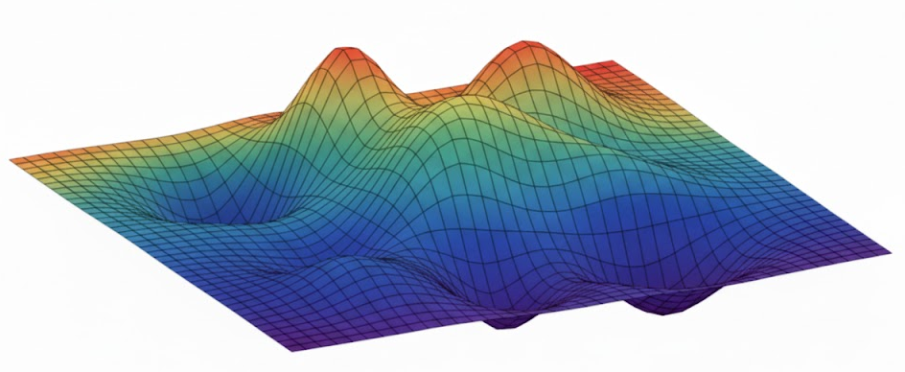
Challenge: Extrapolation, exploration
Extrapolation: at each lab-in-the-loop iteration, want to get sequences better than best measured so far
Exploration: want to find the best performing sequences in a huge search space
Fitness function
Sequence space

Slide 39
Lab in the Loop Revisited
Smart design strategies trading off exploration and exploitation
New scalable assays and smart use of different “tiers” of data, including in-silico
Generative models supporting extrapolation, low-data regimes, multi-objective optimization
Large-scale pre-training on genomic data and beyond

Slide 40
Summary
Biology is extremely complex and “messy”
That’s exactly the type of problem ML is good at
Which is great since drug development needs help
Lots of interesting and difficult challenges

Slide 41
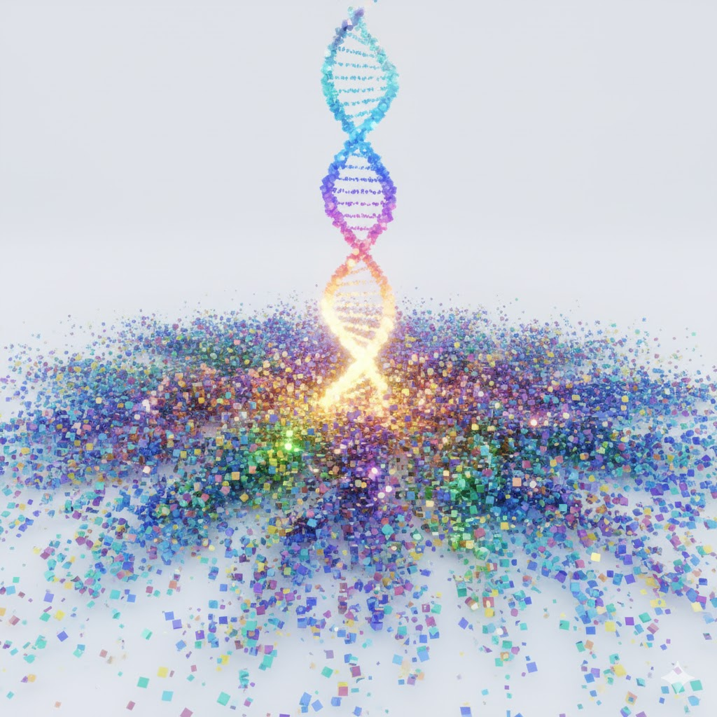
Computer vision is still not “solved” – exciting challenges!
Loads of room for innovation and impact in using ML for biology and medicine

